Slide 1
ACCESS for ELLs
Suite of Assessments
Sabrina Read, WIDA Florida ACCESS Manager
Bureau of K–12 Student Assessment
2023 Annual Statewide Assessment Meeting
September 20, 2023

Slide 2
Agenda
Spring 2023 State Results
Spring 2024 Administration Updates
Spring 2024 Field Test Updates

Slide 3
Spring 2023 ACCESS for ELLs State Results
ACCESS for ELLs
In the 2022-23 school year, 290,930 ELLs in grades K–12 took the ACCESS for ELLs as a paper-based assessment.
Across all grades, 14% of these students were proficient in English.
Alternate ACCESS for ELLs
In the 2022-23 school year, 959 ELLs in grades 1–12 took the Alternate ACCESS for ELLs as a paper-based assessment.
Across all grades, 43% of these students were proficient in English.

Slide 4
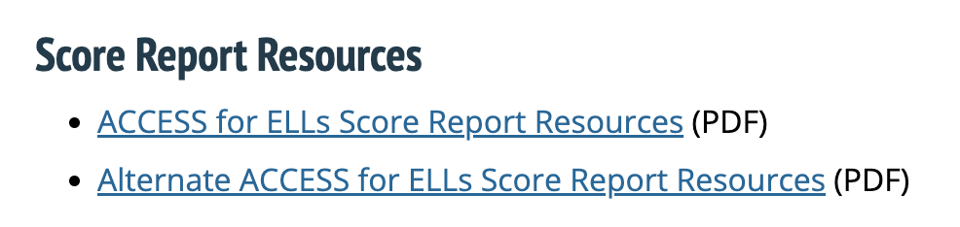
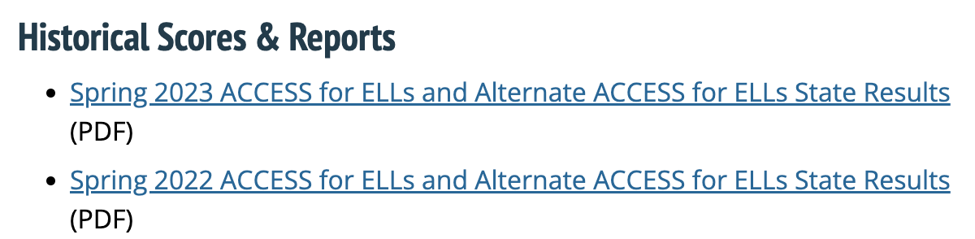
Florida Department of Education’s
ACCESS for ELLs webpage http://fldoe.org/accountability/assessments/k-12-student-assessment/access-for-ells.stml
Assessment Resources
Score Report resources are available for ACCESS for ELLs and Alternate ACCESS for ELLs.
Historical Scores & Reports
Overview of State ACCESS for ELLs results from Spring 2016 to Spring 2023.

Slide 5
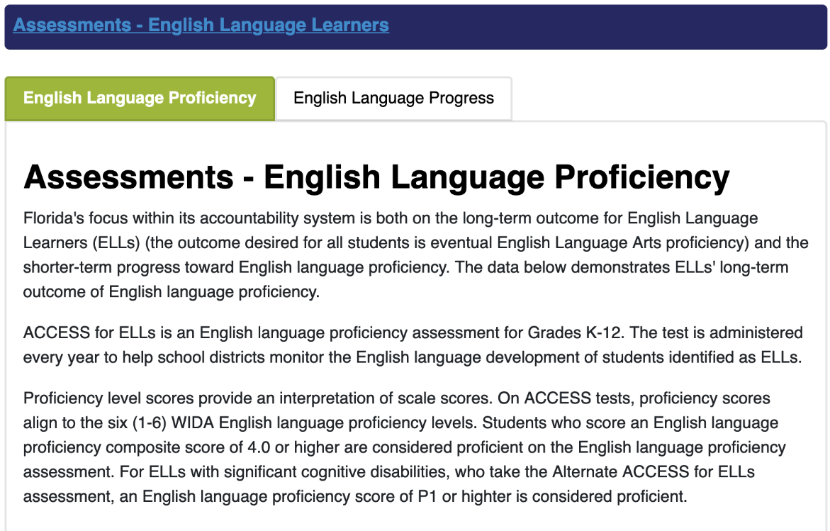
Know Your Schools Portal https://edudata.fldoe.org/
To examine the district and schools’ English Language Proficiency and English Language Progress, visit https://edudata.fldoe.org/.
2022-2023 ACCESS for ELLs data is forthcoming!

Slide 6
2023–2024 ACCESS for ELLs Schedule
Event | Date
Survey 2 State Processing Dates | October 16–November 3, 2023
Pre-ID File to DRC | November 13, 2023
WIDA AMS Test Setup (Available for districts to modify demographic information) | December 22, 2023–March 22, 2024
2nd Pre-ID Upload via FDOE ShareFile by District Assessment Coordinators | January 5, 2024
Delivery of 2024 Administration Materials | January 8, 2024
Additional Test Materials Ordering Window via WIDA AMS – 3 Bulk Orders | January 8–March 8, 2024
2024 ACCESS for ELLs Test Administration Window | January 22–March 15, 2024
Delivery of 2nd Wave of Pre-ID Labels | February 7, 2024
Return of Materials | January 23–March 22, 2024

Slide 7
ACCESS for ELLs
Suite of Assessments
For the Spring 2024 administration, the following assessments will be used to satisfy state and federal requirements for the annual assessment of the English language proficiency of English language learners (ELLs):
  Kindergarten ACCESS for ELLs, a paper-based assessment for students in kindergarten;
  ACCESS for ELLs Paper, a paper-based assessment for students in Grades 1–12; and
  Alternate ACCESS, a paper-based assessment for students in Grades K–12 with the most significant cognitive disabilities.

Slide 8
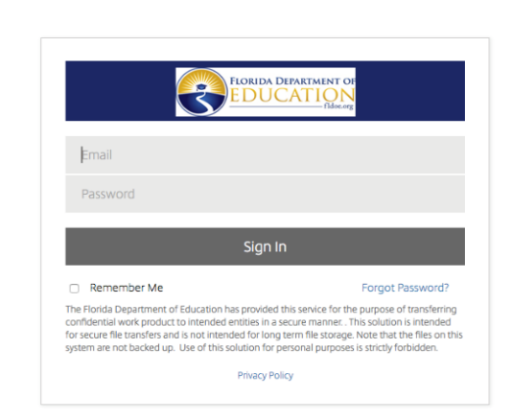
ACCESS for ELLs
ACCESS for ELLs 2023–2024 Resources Folder Pathway
(K–12 Administration > ACCESS for ELLs > Districts > 2023–2024 Resources
The purpose of this folder is to provide all districts with resources to modify/share with participating schools that support understanding of Florida’s policies and procedures related to the ACCESS for ELLs suite of assessments.
  Parent Resources
  Manuals and Ancillary Materials
  Training Resources
  Assessment Agreements and Forms
  2nd Wave Pre-ID Resources
  Data Validation Resources
  Score Report Resources
Notes:
Upcoming 2023–2024 Resources:
ACCESS for ELLs Overview LEAs_2024 PPT
ACCESS Speaking Reliability Training Activity
Spring 2024 Florida ACCESS for ELLs Test Administration Manual
2024 Florida Accessibility and Accommodations Manual
Parent Letters in English and Spanish
WIDA Accounts Flyer
State-specific Webinars
Note: Notification will be provided as resources become available within each folder.

Slide 9
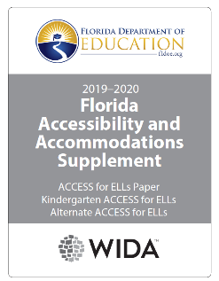
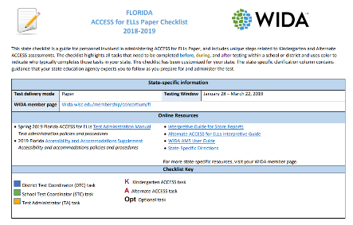
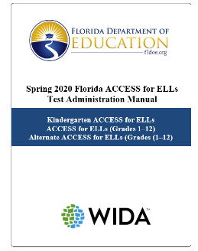
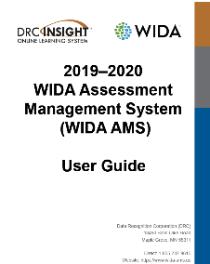
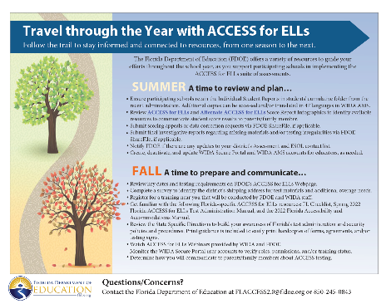
ACCESS for ELLs
Spring 2024 Florida’s Key Resources Coming Soon!
FL Test Administration Manual
FL Accessibility and Accommodation Manual
FL ACCESS Checklist
DAC Resources
WIDA AMS User Guide
Notification will be provided to DACs when Florida-specific resources are posted to FDOE ShareFile.
Notes:
FL Checklist provides a list of roles and responsibilities, with key website and notes specifying the guidance provided in the FL TAM, FL AAM, State-Specific Directions, and the WIDA AMS User Guide. Materials will be available by mid-October.

Slide 10
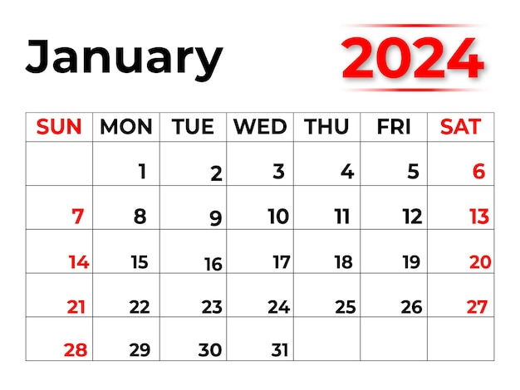
ACCESS for ELLs
Students to Be Tested
All students enrolled in the district (grades K–12) and classified ELL, with a code of “LY” on the 1st day of the test administration window, must be administered one of the following English language proficiency assessments:
  Kindergarten ACCESS for ELLs,
  ACCESS for ELLs, or
  Alternate ACCESS.
(continued on next slide)

Slide 11
ACCESS for ELLs
Students to Be Tested (cont.)
ELLs with disabilities participate in the statewide assessment program by taking one of the following English language proficiency assessments with or without accommodations:
  Kindergarten ACCESS for ELLs,
  ACCESS for ELLs, or
  Alternate ACCESS.
Note: Document the participation and accommodation decisions in the student’s IEP or Section 504 Plan and in the student’s ELL Plan.

Slide 12
Participation Criteria for
Alternate ACCESS
Florida’s Alternate ACCESS participation criteria is as follows:
  The student is classified as ELL, with a code of “LY” on the first day of the testing window (January 22, 2024).
  The student has a most significant cognitive disability as defined in Rule 6A-6.03411(1)(f), Florida Administrative Code (F.A.C.).
  The student receives special education services under IDEA (2004) and requires extensive direct individualized instruction and substantial supports to achieve measurable gains in the grade and age-appropriate curriculum.
  The student is or will be participating in Access Points Curriculum and/or Statewide, Standardized Alternate Assessment based on criteria outlined in Rule 6A-1.0943(5), Florida Administrative Code (F.A.C.).
Determining whether a student should be tested on ACCESS for ELLs Paper or Alternate ACCESS is a decision best made by the student’s IEP team.

Slide 13
ACCESS for ELLs
Tier Placement and Test Materials Ordering via Survey 2
To ensure that the district receives the necessary test materials for the Spring 2024 ACCESS for ELLs administration, it is imperative that all ELL students with a code of LY, LF, LP, LA, and LZ have a tier designation/code as indicated below.
  All grades 1–12 students with a code of LY have a code of A, B, or C.
    Note: Students who have a most significant cognitive disability and meet the participation criteria for Alternate ACCESS must have a code of D.
  All kindergarten students with code of LY and students in grades K–12 with a code of LF, LP, LA, and LZ have a code of Z.
    NEW: Kindergarten students who have a most significant cognitive disability and meet the participation criteria for Alternate ACCESS must have a code of D.
To review the tier placement guidance, please visit
https://www.fldoe.org/core/fileparse.php/20606/urlt/2324-197279.pdf.

Slide 14
ACCESS for ELLs
Tier Placement and Pre-ID Labels
 | Kindergarten ACCESS for ELLs | ACCESS for ELLs Paper | Alternate ACCESS
Tier Placement on Pre-ID Label via Survey 2 | Z = KG | A = TierA B or C = TierBC | D = ALT
Tier placement assigned via Survey 2 will be listed as the District Student ID on the Pre-ID label and within WIDA AMS.
Note: If the tier changes for a student, schools can proceed to affix label to the Student Response Booklet (i.e., BC to A).
Notes:
(PK-12, Data Element #197279)

Slide 15
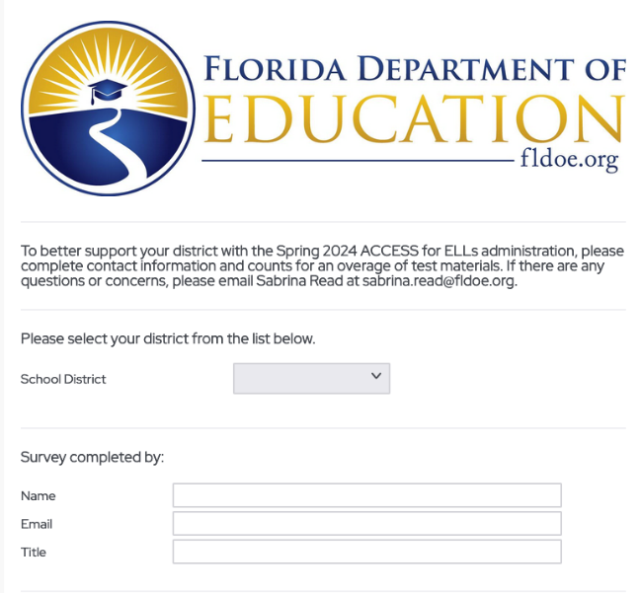
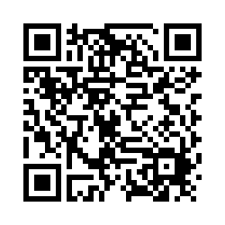
ACCESS for ELLs
Spring 2024 District Shipping & Additional Overage Survey
The purpose of this survey is to confirm the district’s shipping address for initial test materials and request additional overage quantities to reduce the need of ordering materials during the testing window. Note: Accommodated test forms are generated exclusively from Survey 2 enrollments.
Test materials requested via this survey creates a student record assigned to the State Provided School (9999), which requires the destruction of Pre-ID and District/School labels upon receipt.
Districts can elect to use the same counts submitted for the spring 2023 administration. Please identify one individual to complete the survey for the district by Friday, September 22.
Scan the QR Code or visit:
https://uwmadison.co1.qualtrics.com/jfe/form/SV_bOqJBtuzGgtG7no
Notes:
https://uwmadison.co1.qualtrics.com/jfe/form/SV_bOqJBtuzGgtG7no

Slide 16
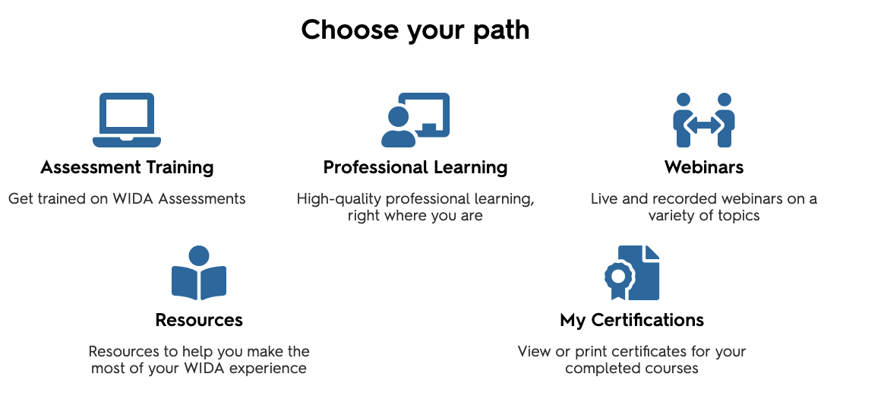
ACCESS for ELLs
Who can be a Test Administrator?
A test administrator can be a state-level certified educator, district-level certified educator, school personnel (including temporary certifications for new teachers and certified substitute teachers), or paraprofessionals articulate in English.
Each assessment’s training course has a general administration quiz via the WIDA Secure Portal, which educators must pass to become certified to administer the assessment.

Slide 17
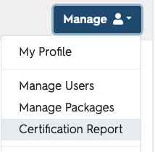
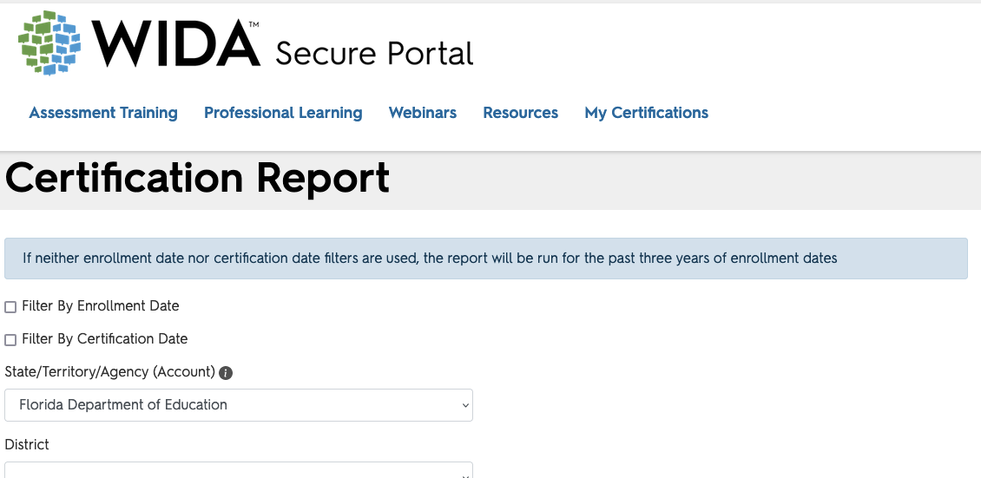
ACCESS for ELLs
WIDA Secure Portal Account Management www.wida.wisc.edu
1. District assessment coordinator manages school-level accounts and assigns permissions via Manage > Manage Users.
Users can update account information and view certifications via Manage > My Profile.
2. District and school assessment coordinators can check on the certification status of test administrators via Manage > Certification Report.

Slide 18
ACCESS for ELLs
Security Requirements of Proctors
Prior to testing, proctors must be informed of their duties and of the appropriate test security policies and procedures. School personnel and non-school personnel may be trained as proctors.
Proctors and anyone who assists with any aspect of test preparation or administration must:
  sign the 2024 Test Administration and Security Agreement and be informed of the test security laws and rules prohibiting any activities that may threaten the integrity of the test;
  sign the 2024 Security Log for each test session; and
  sign the WIDA Non-Disclosure User Agreement (NDUA) electronically via WIDA Secure Portal or hardcopy.

Slide 19
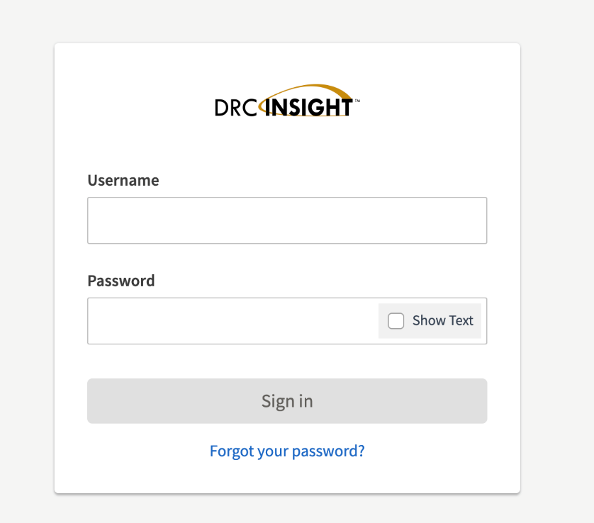
ACCESS for ELLs
WIDA Assessment Management System (WIDA AMS) www.wida-ams.us
New District Assessment Coordinators can submit a request via email to sabrina.read@fldoe.org.
School Assessment Coordinators: District assessment coordinator creates accounts at their discretion. User accounts can be created individually or via file upload.
  Important: WIDA, DRC, and FDOE will not process requests for a new account.
WIDA AMS is a secure portal for district assessment coordinators to update student demographic information, manage test materials, and access score reports.

Slide 20
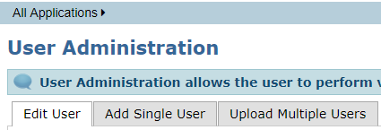

ACCESS for ELLs
Deactivate WIDA AMS Accounts
For user accounts within the 2022–23 administration that should be deactivated, please visit My Applications > User Management > Edit User.
Search by User Role and/or school to narrow the list.
Click the 3rd icon (person) under Action to deactivate an account.
Note: Accounts that remain active from the 2022–23 administration will automatically roll-over in mid-September to the 2023–24 administration.
Inactive Accounts:
Red ball will turn Green

Slide 21
What’s New for Spring 2024 ACCESS for ELLs
Refreshed ACCESS for ELLs Paper training course launched on September 1, to cover improvements to WIDA AMS. Course learning objectives and certification quizzes did not change.
  Test Administrators with training certificates prior to September 2022 must recertify to administer during the Spring 2024 administration.
Alternate ACCESS for ELLs has been redesigned. Beginning in the 2023-2024 school year, its new title is WIDA Alternate ACCESS, and it covers grades K–12. The redesigned assessment training course launched on September 1.
  Alternate ACCESS Test Administrators with training certificates prior to September 2023 must recertify to administer during the Spring 2024 administration.

Slide 22
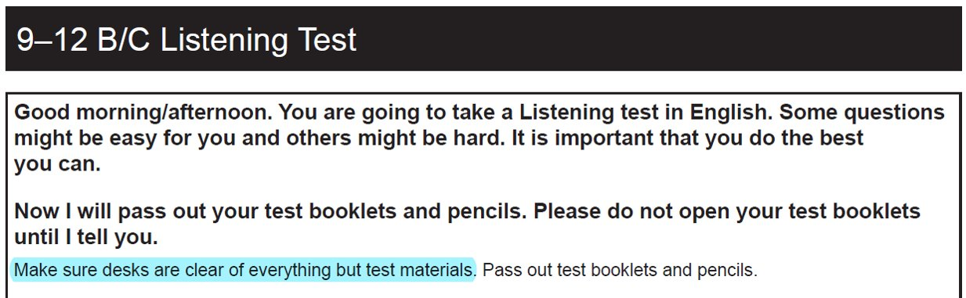
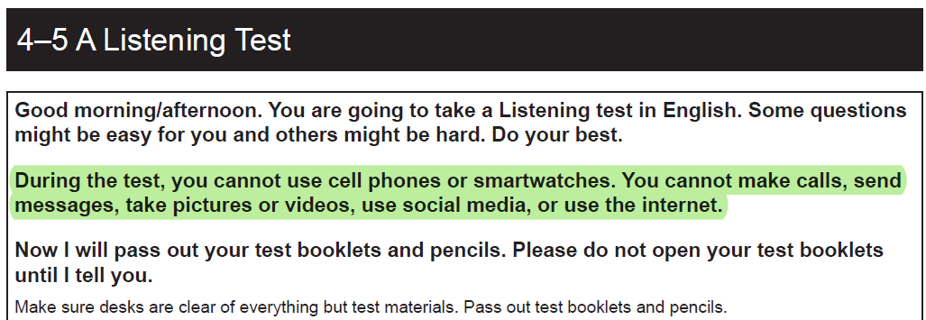
What’s New for Spring 2024 ACCESS for ELLs (cont.)
WIDA has updated test security information to clarify devices that students are not allowed to use during testing.
Notes:
Previously, students were not addressed directly about devices that are not permitted during testing. Students are now addressed directly, and prohibited devices and actions are explicitly mentioned.

Slide 23
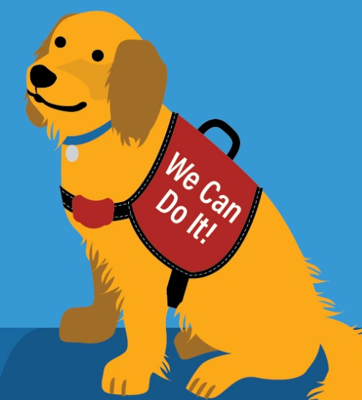
What’s New for Spring 2024 ACCESS for ELLs (cont.)
Alternate ACCESS materials will be recognizable by their new name as well as by the image of the Alternate ACCESS guide dog, Candoo!
Alternate ACCESS test forms now include an Individual Characteristics Questionnaire (ICQ). ICQ information will be reported on the individual student score report to help educators make reclassification decisions.
Accessibility and Accommodations Updates
  Updated guidance for transcribing student responses, such as with Kindergarten ACCESS and Alternate ACCESS, no longer requires a second person present for transcription.
  Updated guidance for the Human Reader Accommodation Script for ACCESS Paper now requires two trained test administrators to provide this accommodation to a student.

Slide 24

ACCESS for ELLs Paper Field Test
Purpose
To vet new content aligned to 2020 Edition of WIDA ELD Standards for operational use on Revised ACCESS Paper. The field test will also link ACCESS Online and Paper Scales, while aligning ACCESS Online and Paper Grade Level Clusters.
Test Administration
The ACCESS for ELLs Field Test only includes Listening and Reading domains.
Each student takes only ONE field test booklet (either Listening or Reading).
The field test will take approximately 20 minutes of additional seat time.
The field test booklet can be administered at the same time as the operational test or within 4 weeks of completing the domain.
HELLO
MY NAME IS
Lingo

Slide 25
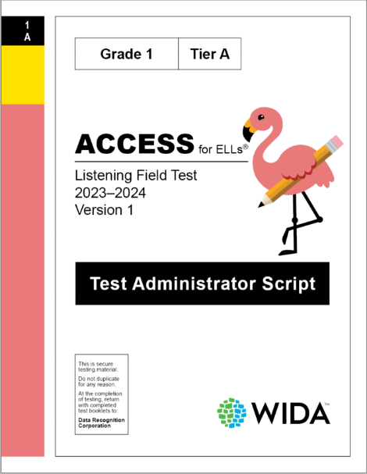
ACCESS for ELLs Field Test Materials
The ACCESS for ELLs Field Test materials will arrive in BROWN boxes and have unique visual markers to indicate their unique purpose to those using them.
Field test materials will have…
  the words “field test” on each and every cover,
  a pink strip along the spine of each field test material,
  pink Pre-ID labels, and
  an image of the field test flamingo, Lingo!

Slide 26
2023–2024
ACCESS for ELLs
Field Test Schedule
Event | Date
WIDA Paper Field Test Webinar | October 24, 2023
Delivery of 2024 Field Test Materials | February 1, 2024
Delivery of 2nd Wave Pre-ID Labels | February 7, 2024
2024 ACCESS for ELLs Field Test Window | February 5–April 19, 2024
Return of Field Test Materials to DRC | February 6–April 26, 2024

Slide 27

ACCESS for ELLs Field Test
Managing Materials
Initial Delivery of Field Test Materials: February 1, 2024
Every school site receiving ACCESS for ELLs test materials for the 2023–24 ACCESS for ELLs test window will receive a box of field test materials. Field Test materials arrive in BROWN boxes with a Lingo sticker.
Additional Material Orders
Additional Field Test materials orders are generated when operational materials are placed by the DAC via WIDA AMS.
Deadline to Return Materials: April 26, 2024
Field test materials must be returned to DRC via UPS no later than April 26, 2024. A preliminary missing materials report will be provided to the DAC at the end of May 2024.

Slide 28
ACCESS for ELLs
Contact Information
Florida Department of Education
Bureau of K–12 Student Assessment
Sabrina Read, WIDA Florida ACCESS Manager
  Telephone Number: 850-245-0843
  Email: Sabrina.Read@fldoe.org
WIDA Client Services Center
  Toll-Free Telephone Number: 1-866-276-7735
  Email: help@wida.us
Data Recognition Corporation (DRC)
  Toll-Free Telephone Number: 1-855-787-9615
  Email: WIDA@datarecognitioncorp.com

