Slide 1
New Assessment Contract Webinar Summer 2020 and Beyond
December 12, 2019

Slide 2
Call Reminders
Enter questions in the Chat feature
Address your question to everyone
Questions will be answered after all presenters have finished
A recording of this webinar, the Q & A, and this presentation will be distributed

Slide 3
New Contract
Contract 20-652 – Awarded to the American Institutes for Research (AIR)
The first test administration will be in Summer 2020
Includes all ELA, Mathematics, Science, and Social Studies Assessments
Replaces two separate contracts: 14-652 with AIR and 16-660 with Pearson
Data Recognition Corporation (DRC) and Pearson will work as subcontractors
Superintendents will receive a memo from Chancellor Oliva next week

Slide 4
TIDE
TIDE will be used for ELA, Mathematics, Science, and Social Studies assessments:
PreID uploads
Student data management
Additional orders
PreID label printing
Participation reports
Document tracking
Discrepancy resolutions

Slide 5
Computer-Based Testing
AIR’s Secure Browser and TA Interface (TDS) will be used for ALL computer-based assessments (ELA, Math, Science, and Social Studies).
One log in process and one management system for all CBT.

Slide 6
PearsonAccess Next
Results reporting
SS, SRD, DRS, SRS, SAR/DAR
ISR access/printing
ISR PDFs available when scores are reported (as they are now)
All reports will come in one shipment from Pearson
Pearson is aware of and working on certain requests for formatting the PDF files.

Slide 7
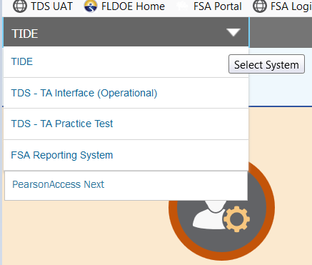
Access to Systems
You will use ONE set of login credentials for all sites, and will be able to navigate to PA Next from TIDE once logged in.

Slide 8
Paper-Based Testing
DRC will continue to print, ship, receive, and scan ELA and Mathematics tests.
Pearson will continue to print, ship, receive, and scan Science and Social Studies tests.
Receiving and returning materials instructions for PBT will remain very similar if not the same as in prior years.
Districts will receive separate shipments and return labels as they have in the past.

Slide 9
What is being combined?
One Florida Statewide Assessment Portal for all resources and links (will remain www.FSAssessments.org).
One version of the Test Administration Manual and training resources for each administration (one PBT and one CBT in spring).
One Help Desk for all systems.
One practice test site and platform for all subject tests.

Slide 10
What is being combined?
One version of Understanding Florida Reports.
One Secure Browser and one set of Technical Requirements.
One Infrastructure Trial test.
NGSSS tests will be added to the Accommodations Guide.
PBT documents and ancillaries will have a uniform appearance.

Slide 11
What is going away?
ISR USB drives
PearsonAccess Next Training Center
Avocet
Proctor Caching
TestNav 8
NGSSS demographic page/grids on test book covers (PreID labels will be required)
Florida Pearson Resource Center

Slide 12
Summer 2020 EOCs
Resources available in June
Updates to the portal
NGSSS practice tests in the secure browser (same items and item types for Bio/Civ/USH – multiple choice)
Test Administration Manual
Combined manual including all scripts (Alg 1, Bio, Civ, Geo, USH)
Online only

Slide 13
Summer 2020 EOCs
Spring 2020 administration ends 5/29
Scores reported (FSA-R) no later than Tuesday, 6/30
After 6/1 – All practice tests, manual, resources, and updated portal available
Summer 2020 administration begins on 7/13
NGSSS EOC practice not required for Summer 2020 in new platform

Slide 14
AIR Assessment – Cambium Learning
AIR Assessment was acquired by Cambium Learning.
AIR will continue to perform in the same capacity as required in the contract.
There will be no impact on Florida assessments, nor on the department’s interactions with the contractor.
You may see name updates from AIR Assessment to Cambium Assessment after the Spring 2020 administration.

Slide 15
Questions?

