Slide 1
DAC/AAC Meeting – FSAA Update
Angela Leigh Nathaniel
September 10, 2020

Slide 2
Agenda
Important Dates
What’s New in 2021
Change the Online System
2020 Fall Makeup
Test Security
FSAA 2020 Q&A
Block Scheduling
Monitoring 1% Compliance
Service Center
Questions

Slide 3
Important Dates: Performance Task
Preorder Materials – EOCs, Braille, One-Sided
September 21–November 4, 2020
Administration Training Modules 1–3/Tutorials
October 2020–March 31, 2021
Administration Support Documents
February 2021
Online System Training Module 4/Tutorial
February–May 1, 2021

Slide 4
Important Dates: Performance Task – Fall Makeup
Event
Date
Online System Opens
Fall Makeup Assessment Materials in Districts
Student Testing Window
Student Responses Entered into Online System
Return of Test Materials to Piedra Data Services
September 14, 2020
September 14–25, 2020
September 28–December 18, 2020*
No Later Than 11:59 p.m. (ET) on December 18, 2020
No Later Than January 15, 2021

Slide 5
Important Dates: Performance Task – Spring 2021
Performance Task
Performance Task
Elementary and Middle School, Civics EOC
Materials in Schools: February 15–19, 2021
Testing Window: March 1–April 16, 2021
Return Materials: May 14, 2021
High School and EOCs
Materials in Schools: March 8–12 OR March 15–19, 2021
Testing Window: Upon Receipt Through April 30, 2021
Return Materials: May 14, 2021

Slide 6
Important Dates: Datafolio
Datafolio
Datafolio
Assessment View System (AVS) Opens: August 31, 2020
Collection Period #1 (CP #1): August 31–October 9, 2020*
AVS Upload of CP #1 Evidence: August 31–November 13, 2020
Goal Setting: Upon Completion of CP #1
CP #2: November 16–December 18, 2020
CP #2 Evidence Upload: November 16, 2020–March 9, 2021
CP #3: March 1–26, 2021
CP #3 Evidence Upload: March 1–April 2, 2021
AVS Closes: April 2, 2021 at 11:59 p.m. (ET)

Slide 7
What’s New in 2021

Slide 8
Change to FSAA Online System
If the teacher does not upload the student response template or input student responses, he or she will receive an error message and be allowed to go back and fix it.

Slide 9
FSAA 2020 Fall Makeup

Slide 10
Fall Makeup – Request for Materials
21 districts, 981 tests ordered (increase of 6 districts and 844 tests from 2019)
Grade 10 ELA (ELA 2): 503 (+444)
Algebra 1: 478
Braille/Tactile: 0

Slide 11
Fall Makeup – Materials
Auxiliary Materials
Not shared
Test booklet and auxiliary materials for each content area being assessed will be shrink-wrapped together as a set – same security number on all barcoded materials
Kitted at the school level

Slide 12
Fall Makeup – Materials
Auxiliary Materials
Materials that were ordered during the window will have a label with district, school, content area, and package contents on the front of the kits.
For subsequent orders made after the window closes, the label will only include content area and package contents.

Slide 13
Fall Makeup – Materials
Auxiliary Materials
Districts will receive the following from Piedra Data Services:
1 district administration and return materials kit (including 1 copy of the Procedural Manual),
1 school administration and return materials envelope for each school,
and shrink-wrapped test material sets.

Slide 14
Fall Makeup – Materials
Auxiliary Materials
Distribution of materials should be handled like other administrations.
There will be no online system for ordering additional materials. To place an order, districts should contact Piedra Data Services by phone (305-254-9986) or e-mail (fl-alt@piedradata.com).

Slide 15
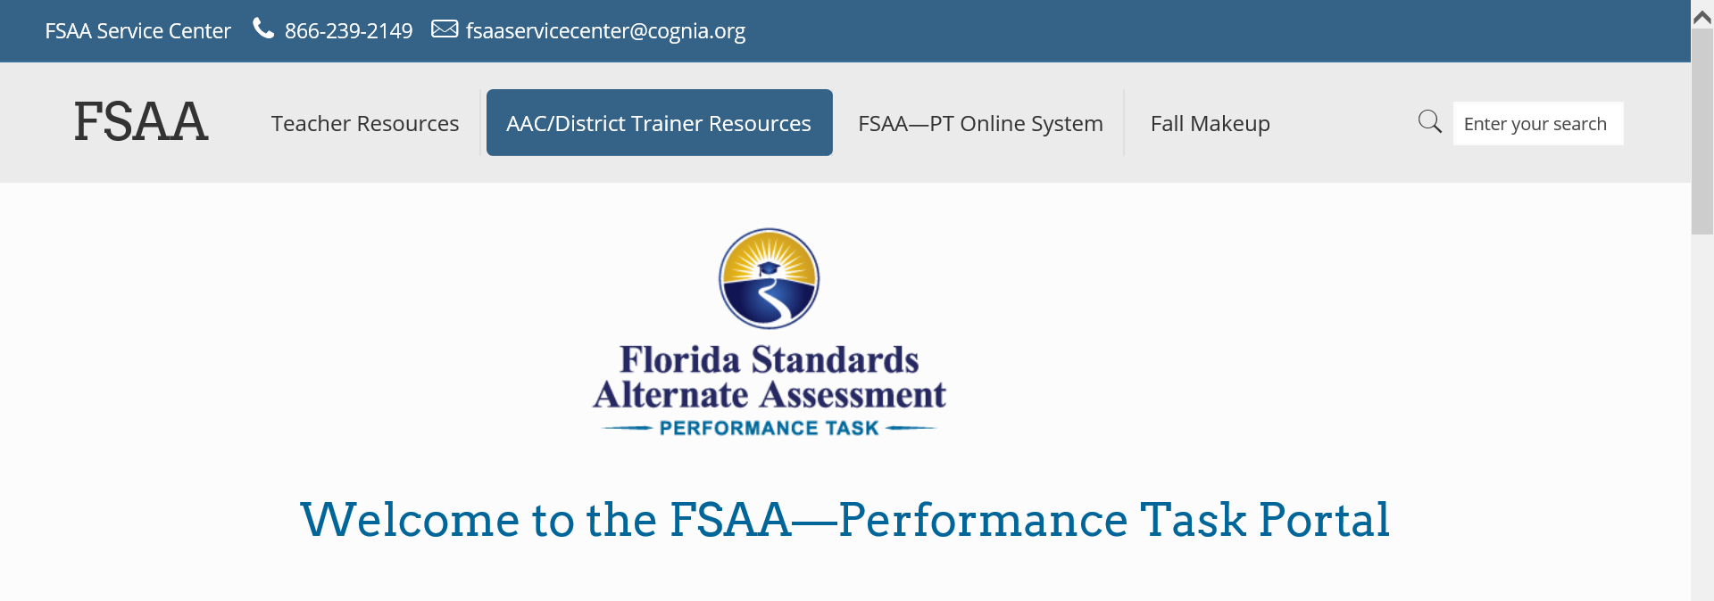
Fall Makeup – Resources
Performance Task Fall Makeup
Training materials and resources are available on the FSAA Portal under the Fall Makeup tab.

Slide 16
Online Management System

Slide 17
Online Management System
Window
September 21–November 4, 2020
Preordering Materials
Braille/Tactile Graphics
All grades, content areas, and EOCs available in UEB only
Indicate contracted or uncontracted

Slide 18
Online Management System
Ordering Materials (Cont’d)
One-Sided Response Booklets
EOC Assessments – Early, valid, and reliable counts
Materials for students completing courses with EOCs in 2020 MUST be ordered using the Online Management System (e.g., Access Algebra 1B).
EOCs are ordered by school.
Indicate the course name and the number of students taking the EOC.

Slide 19
Online Management System
Verification System
Must have the student’s FLEID to edit or add students in the system
Verify survey 2 student demographic information (December 2020)
View/edit shipping contact information

Slide 20
Online Management System
Verification System (Cont’d)
Add additional students
Grades 3–10: Required
Grades 11 & 12: Optional*
Order additional test materials (Available beginning February 2021)
Schedule pickup of materials (Available beginning February 2021)

Slide 21
Test Security

Slide 22
Test Security
Securely maintain all test materials before, during, and after test administration.
Store in a locked storage room.
Return all materials to the School Assessment Coordinator (SAC).
Maintain the Test Materials Chain of Custody Form.

Slide 23
Test Security
ALL involved staff must sign the Test Administration and Security Agreement.
AACs and administrators must also sign the Test Administrator Prohibited Activities Agreement.

Slide 24
Test Security
Breaches of Administration
Report possible breaches (e.g., secure test content photographed, copied, or otherwise recorded) to the SAC.
SAC reports possible breach to the district coordinator (DC).
DC contacts FDOE with a plan of action.
DC provides a written report within 10 calendar days.

Slide 25
Test Security
Breaches of Administration (Cont’d)
DC completes the Breach of Administration Report and faxes it or e-mails* it to FDOE.
*Confidential student information must not be communicated via e-mail.

Slide 26
Test Security
Missing Materials
SAC verifies the packing list; reports missing or mispackaged materials to the DC.
School-Level Responsibilities:
Investigate any report of missing materials.
If the materials are not found, the SAC contacts the DC.

Slide 27
Test Security
Missing Materials (Cont’d)
District Coordinator Responsibilities
Interview appropriate staff.
Send a written report to the Bureau of K–12 Assessment within 30 calendar days, including changes to procedures to prevent reoccurrence.
Complete and fax or e-mail* the Missing Materials Report to FDOE.

Slide 28
Block Scheduling

Slide 29
Block Scheduling
If your district has schools implementing block scheduling this year where students will have different courses in semesters 1–2 and this will impact students being assessed via the FSAA—Datafolio, please contact me at Angela.Nathaniel@fldoe.org.

Slide 30
Frequently Asked Questions

Slide 31
2020 FSAA FAQ
1. Do students who were enrolled in Access Algebra 1 in spring 2020 need to take the Algebra 1 EOC assessment before using a comparative score to meet this graduation requirement?
No. Students who were scheduled to take the Algebra 1 EOC in spring 2020 are not required to attempt the Algebra 1 EOC before using a Geometry EOC comparative score to meet the Algebra 1 EOC assessment graduation requirement.

Slide 32
2020 FSAA FAQ
2. Are students who met graduation requirements in 2019–20 but deferred receipt of their diploma required to take and pass the FSAA Grade 10 ELA 2 and Algebra 1 EOC assessments to fulfill graduation requirements?
No. Students who were seniors in 2019–20 and were scheduled to graduate in the spring of 2020 and had not yet taken or passed the FSAA Grade 10 ELA 2 and Algebra 1 EOC assessments have the requirement to pass those assessments waived. This includes (senior) students who were scheduled to retake the spring assessment as well as those who did not sit for or complete the assessment. Additionally, this applies to seniors who were otherwise eligible to graduate but whose IEP teams deferred receipt of their diploma.

Slide 33
2020 FSAA FAQ
3. Are students who were not seniors in 2019–20 required to take and pass the FSAA Grade 10 ELA 2 assessment?
Yes. All students who were not graduating seniors in 2019–2020 and have yet to take and/or pass the FSAA Grade 10 ELA 2 assessment must still meet the exit criteria by passing that assessment during a future administration. A student with a disability (SWD) who has attempted the exam at least once may be eligible to have his or her score waived. This applies to SWDs participating in the FSAA—Performance Task and FSAA—Datafolio.

Slide 34
2020 FSAA FAQ
4. Should students who missed the FSAA Grade 10 ELA 2 and/or Algebra 1 EOC opportunity in spring 2020 participate in the FSAA Fall Makeup administration?
While students may participate in the ELA 2 Makeup assessment, it is recommended that these students wait and attempt the assessment in the spring of 2021 so that they may benefit from additional instruction.
For Algebra 1, if these students are enrolled in Access Geometry in the 2020–21 school year, it is recommended that these students wait to take the Geometry EOC and use the comparative score option. Please note that an unsuccessful attempt on the Geometry EOC may be used as documentation for a waiver of results.

Slide 35
2020 FSAA FAQ
5. If students participating in the FSAA—Datafolio do not return to brick-and-mortar schools, can the assessment be administered virtually?
No. Unlike a typical performance-based assessment, the administration of the FSAA—Datafolio depends on the assistance provided by the teacher to help the student engage in and respond to items. Teachers work with students to provide varying levels of assistance (LOAs) during classroom instruction and collect data on the accuracy of the assigned engagement level. While parents/guardians may assist the student in the provision of virtual direct instruction by modeling the LOAs under the guidance of the teacher, in accordance with test security policies and procedures, the student’s parent/guardian cannot be present during an assessment.

Slide 36
2020 FSAA FAQ
6. May students who participated in the 2019–20 FSAA—Datafolio and were assessed in ELA 2 and/or the Algebra 1 EOC be considered to have “attempted” the assessment(s) and, therefore, to have met the eligibility requirements for a waiver of results?
Yes. For students who participated in the FSAA—Datafolio, IEP teams may determine locally whether the work completed and submitted during the 2019–20 school year is sufficient documentation to be used for a waiver of results. No retesting is required for these students.

Slide 37
2020 FSAA FAQ
7. Does this apply to high school students who completed the Spring 2020 FSAA—Performance Task ELA 2 and/or Algebra 1 EOC assessments?
Yes. This also applies to any students who completed the FSAA—Performance Task before testing was canceled and whose responses were uploaded into the FSAA—Performance Task Online System, but no score information was provided from the state. This would also apply to students who are identified as having “completed” the FSAA—Performance Task.

Slide 38
2020 FSAA FAQ
8. For students with disabilities (FSA and FSAA—PT) who missed the opportunity to participate in a graduation test in spring 2020, what are their options to meet these requirements or apply for a waiver of results?
Students who were scheduled to take the graduation tests that were canceled in spring 2020 are not required to take those tests in the future, but they are still required to meet these graduation requirements (non-seniors). They have multiple opportunities to meet these requirements:

Slide 39
2020 FSAA FAQ
Grade 10 ELA
Grade 10 FSA ELA Retake/FSAA Fall Makeup/FSAA Spring Grade 10 ELA 2
SAT concordant score
ACT concordant score

Slide 40
2020 FSAA FAQ
Algebra 1 EOC
FSA Algebra 1 EOC Retake/FSAA Fall Makeup/FSAA Spring Algebra 1 EOC
FSA/FSAA Geometry EOC comparative score
PSAT comparative score
SAT comparative score
ACT comparative score
Any student in this spring 2020 cohort who is unsuccessful on an attempt at any graduation test (listed above) AND is eligible for a waiver based on IEP team recommendations may use that attempt in their waiver documentation.

Slide 41
FSAA Participation: Monitoring for Compliance

Slide 42
Participation in Florida Alternate Assessment
Title I of the Elementary and Secondary Education Act of 1965 (ESEA) requires that only students with the most significant cognitive disabilities may take an assessment using alternate standards; it also limits the number of students that a state may assess with an assessment using alternate standards to no more than 1.0 percent of all students in the grades assessed in a state.

Slide 43
Consequences for Exceeding the Cap
If the state continues to have a participation rate in alternate assessment over 1.0 percent, the U.S. Department of Education may consider (per USED’s letter to FDOE received on June 19, 2019) “Withholding Title I, Part A State administrative funds” and requiring the state to submit a plan to come into compliance with the 1.0 percent cap and participate in joint monitoring calls.
Notes:
Per the U.S. Department of Education’s letter to Commissioner Corcoran received on June 4, 2019 – suggestion was made to work on Florida’s definition

Slide 44
Alternate Assessment and the 1% Cap
Memo sent to districts in July 2017 explaining that the 1% cap is at the state level and appropriate participation in the alternate assessment would be monitored by the bureau
FDOE BEESS will be conducting a targeted monitoring for compliance exercise with identified districts.
LEA written justifications were required of all districts over the 1% participation rate.
Florida is currently at 1.5% in ELA, 1.6% in Math, and 1.6% in Science (2018–19).
The majority of districts are above 1%.

Slide 45
FSAA Participation Determination
How a student will participate in the statewide assessment program is an IEP team decision, but the student must be identified as a student with a significant cognitive disability in order to participate.
Annual parental consent for alternate standards and assessment is required.
IEP teams are encouraged to use the Assessment Planning Resource Guide for IEP Teams to help in the decision-making process.
Student standards, courses, and assessments must align.

Slide 46
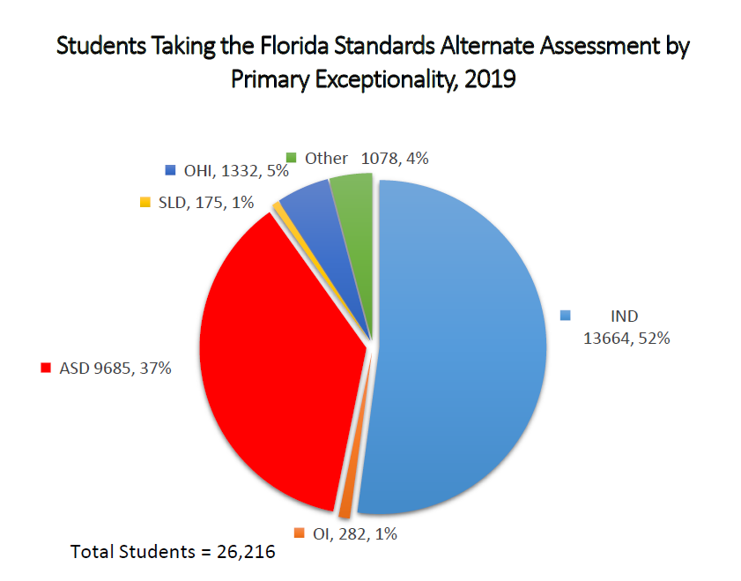

Slide 47
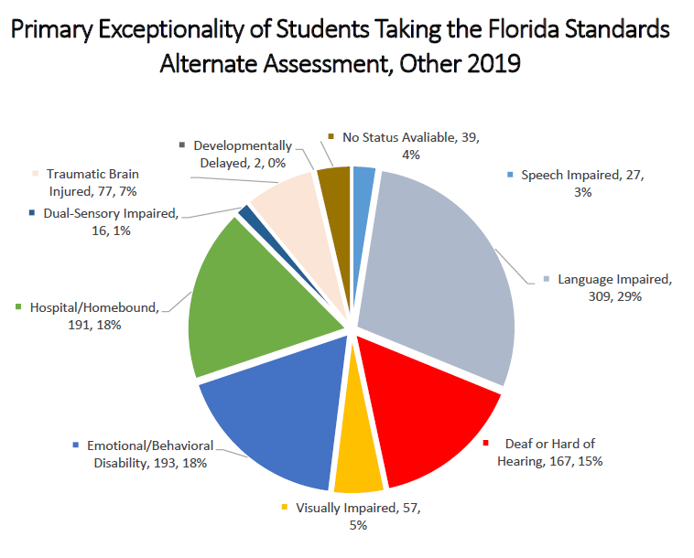

Slide 48
Florida Versus National Averages for Alternate Assessment Participation – 3 Years

Slide 49
1% Alternate Assessment Participation Comparison for 2017-2018: Reading

Slide 50
1% Alternate Assessment Participation Comparison for 2017-2018: Math

Slide 51
Compliance and the 1% AA-AAAS Cap
Per Rule 6A-6.03018, Florida Administrative Code (F.A.C.), and Title 34, Section 300.8, Code of Federal Regulations (C.F.R.), students identified with a specific learning disability may not have a learning problem that is a result of intellectual factors and are prohibited from participation in Florida Standards Access Points instruction and the FSAA.
34 C.F.R. § 300.324 requires the periodic review and revision of IEPs, to include ensuring that continued participation in the FSAA is appropriate (e.g., if a student should have perfect scores on the FSAA).
Title I of ESEA requires that only students with the most significant cognitive disabilities may take an assessment using alternate standards, and 34 C.F.R 300.320 requires that IEPs contain a statement of why the child cannot participate in the regular assessment.
Section 1003.5715, Florida Statutes, requires parental permission, multiple documented attempts and no response, or due process for instruction of a student in alternate standards and FSAA participation.

Slide 52
2020–21 Monitoring for Compliance on FSAA Participation
25 districts have been selected for intensive or moderate participation and will be notified by the end of September.
Both district-level and student-level self-assessment and documentation submission will be required as part of this activity.
Senior leadership has extended the deadline for this activity to June 1, 2021.

Slide 53
Virtual IDEA Compliance Convening: Monday 9/14/20 (9a.m.–11:30am & 1:30 p.m.–4p.m.)
Register in advance for this meeting:
https://zoom.us/meeting/register/tJEldOmqrTMuGtKu79AbVR8wxu-uDjFYuqvH
Monitoring for Compliance 2020–21 Updates (including FSAA Participation Monitoring)
Other compliance topics include evaluation and transition compliance; and requirements for districts related to state complaints, mediation, and due process.

Slide 54
FSAA Service Center

Slide 55
Contact Information
FSAA Service Center
Monday–Friday 8:00 a.m.–5:00 p.m. (ET)
Extended hours during testing window: 7:00 a.m.–8:30 p.m. (EST)
Phone: 866-239-2149
Fax: 866-283-2197
E-mail: FSAAServiceCenter@Cognia.org

Slide 56
Contact Information
DOE – Policy questions
Angela Nathaniel, Program Specialist
Angela.nathaniel@fldoe.org – 850-245-0972
Laura Bailey, Project Manager
Laura.bailey@fldoe.org – 850-245-0722
Fax: 850-245-0771

Slide 57
Questions?

