Slide 1
Test Delivery System and Reporting
FCLE Postsecondary Training Webinar
October 15, 2021
Copyright © 2021 Cambium Assessment, Inc. All rights reserved.

Slide 2
Objectives
After viewing this presentation, you should be able to:
Use the TA Interface to start and run a test session
View student test settings and accessibility resources
Monitor the testing process
Pause and stop a test session
Administer a test remotely
Access Results
Notes:
After viewing this presentation, you should be able to:
Use the TA Interface to start and run a test session
View student test settings and accessibility resources
Monitor the testing process
Pause and stop a test session
Transfer sessions between computers and mobile devices
Print test session information
Exit and log out of the TA Interface

Slide 3
System Requirements
To get started setting up your student workstations, you should make sure your devices are supported
Current system requirements available at: https://fsassessments.org/supported-systems-requirements.html

Slide 4
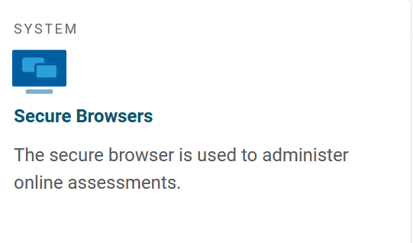
Where Can I Download the Secure Browser?
Downloading the Secure Browser
Find basic installation instructions and download the Secure Browser from the FSA portal at https://fsassessments.org/secure-browsers.html

Slide 5
Activating Your TIDE Account
FCS ITA accounts have been provisioned by FDOE; SUS ITA accounts will be established by the SIA at a later time.
If your account has been provisioned, you should have received an activation email with a link to the Reset Your Password page in TIDE where you can set up your password to log in to TIDE and other applicable CAI systems.
This link expires 15 minutes after the email is sent. If you do not set up your password within 15 minutes.
If you do not receive an account activation email, check your spam folder. Emails are sent from DoNotReply@cambiumassessment.com, so you may need to add this address to your contact list.

Slide 6
Activating Your TIDE Account
To activate your account:
Click the link in the activation email. The Reset Your Password page appears.

Slide 7
Test Delivery System (TDS)
The Test Delivery System (TDS) has two components,
Test Administrator (TA) Interface: Test proctors use the TA Interface to create and manage test sessions.
Student Interface: Students use the Student Interface in the secure browser to access the testing site.

Slide 8
Test Administrator Interface

Slide 9
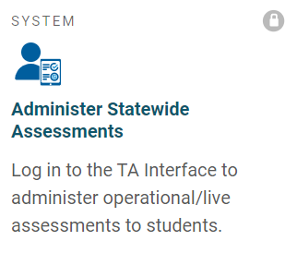
Test Administrator Interface (TA Interface)
Introduction:
Test Administrators = Test Proctors
Test Proctors can use almost any modern browser (Internet Explorer, Safari, Chrome, Firefox, etc. Please see the supported systems page of the portal at: https://fsassessments.org/supported-systems-requirements.html
Test Proctor accounts will have been provisioned in TIDE by either the SIA, ITC, or Campus Test Coordinator.
TA Interface can be accessed by going to the Florida Statewide Assessments Portal.
Click the Administer Statewide Assessments card.
On the Login page, enter your email address and password.
Click Secure Login.

Slide 10
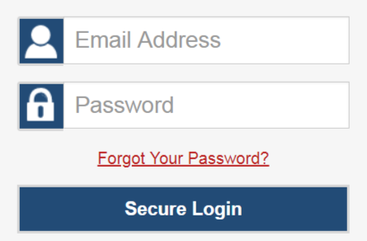
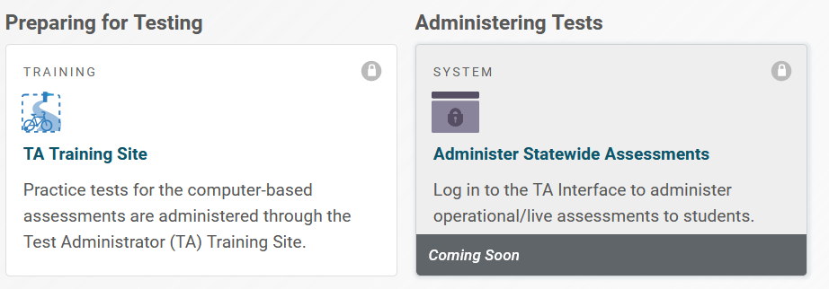
Logging in to the TA Interface

Slide 11
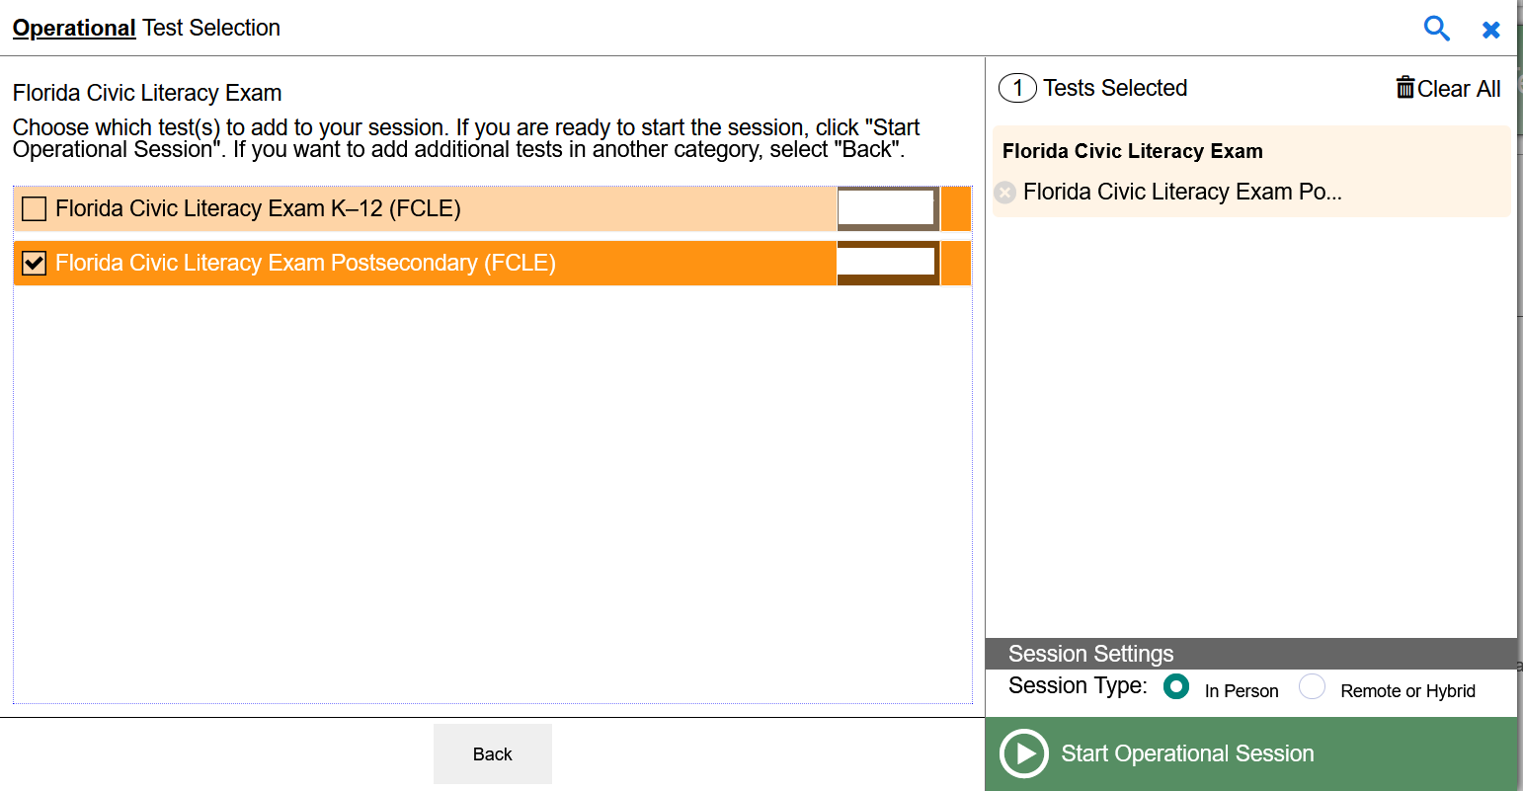
Create a Test Session: Test Selection
Starting a Test Session
Select the test you will administer [Postsecondary FCLE] in the session from the Test Selection window.
Click Start Operational Session.

Slide 12
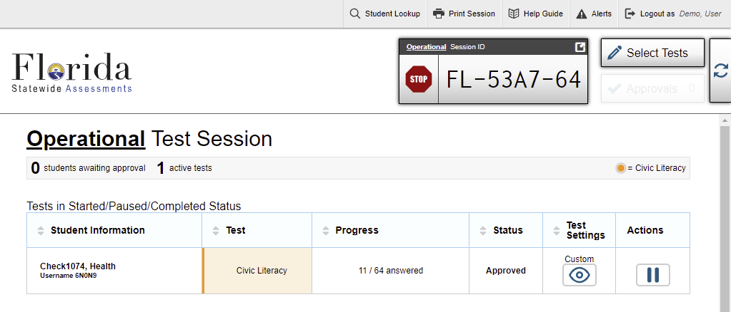
Session ID
A Test session ID is created.
Display the Session ID (found at the top of the screen) where all students in your room can see it.
Have students sign into the Student Interface through the secure browser using their first names and usernames, which are found on their test tickets and the Session ID that is displayed where all students can see it. (Shown later)

Slide 13
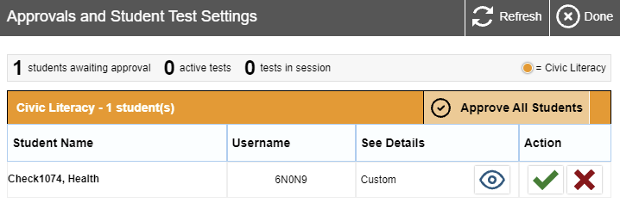
Approving Student Entry
After students select their tests, click the Approvals button.
To review a student’s test settings, click the test settings icon in that student’s row. If applicable, select appropriate accommodations.
To approve individual students for testing, click the approve icon in the Action column for each student. Alternatively, click the Approve All Students button located to the right of the subject to approve all students.

Slide 14
Approving Student Entry
2
Notes:
Once you start the test session and students log in, you must approve their test settings before they can access their tests. It is very important that you pay close attention to the test name prior to approval to be sure that students have selected the appropriate test. To approve students for testing, click the Approvals button next to the session ID. A list of students will display, organized by test name. You should review the list to make sure that all students chose the correct content area and test. You should also ensure that all the settings for each student are correct. This is done using the Eye button in the See Details column. We will talk more about that in a few moments.
If no changes are needed, select Approve All Students to admit all students to the session. You will see a confirmation message appear after clicking Approve All Students. If a student selected an incorrect test, you must deny that student entry to the test session by clicking the X button in the Action column.

Slide 15
Denying Student Entry
Deny entry to a test session in these circumstances:
The student is not supposed to enter this session.
The student’s demographic information is incorrect.
The student’s required accommodations are incorrect.
Notes:
Although you can approve all students at the same time, students must be individually denied entry into the test session.
You should deny students entry into the session in these circumstances:
• The student is not supposed to enter this session.
• The student’s demographic information is incorrect.
• The student’s required accommodations are incorrect.
Denying the student entry into the test session will not prevent other approved students from beginning their tests.
If the student’s test settings are incorrect, the settings must be updated in TIDE or the TA Interface before the student takes the test. Contact your School Test Coordinator or District Test Coordinator to have the settings updated. This will prevent resetting the test for the student later. Please note that the changes may not be immediate.
Note that no settings can be changed while the student is actively testing. Once a student begins testing, the language option cannot be changed without resetting the test opportunity. Updates to background color or font size will take effect only after the student logs out and then resumes testing.

Slide 16
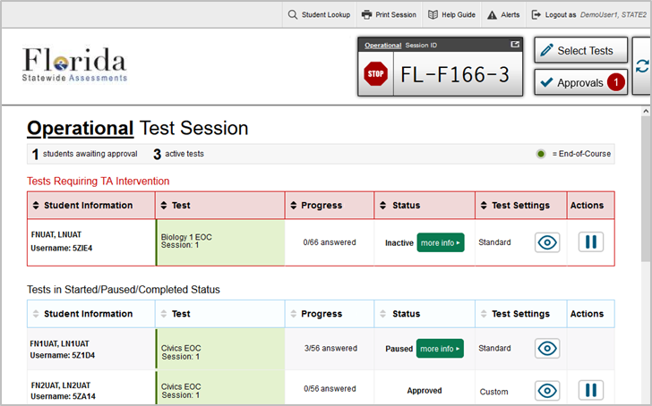
Monitoring Student Progress
Once students are testing, this is the main screen that Test Proctors will see.
Test Proctors can monitor:
Who is testing?
Which test is being administered
How many items have been answered
What is the test status (Paused, Approved)
The test settings
Test Proctors can also pause a students test and approve students for testing.

Slide 17
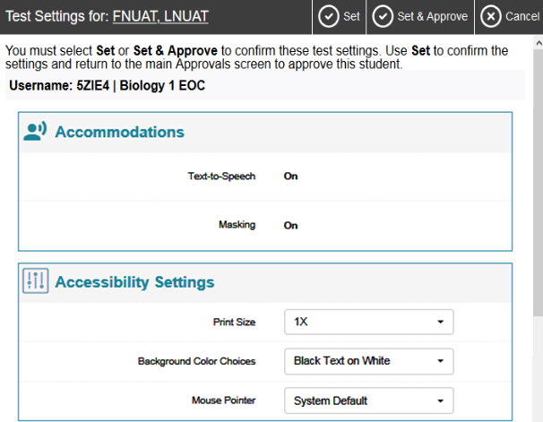
Test Settings Screen
Students can adjust accessibility settings (e.g., print size, mouse pointer) when entering the test or TAs can make adjustments on the Test Settings screen.
Accommodations are set through TIDE, or Test Proctors can test accommodations via the TA Interface.

Slide 18
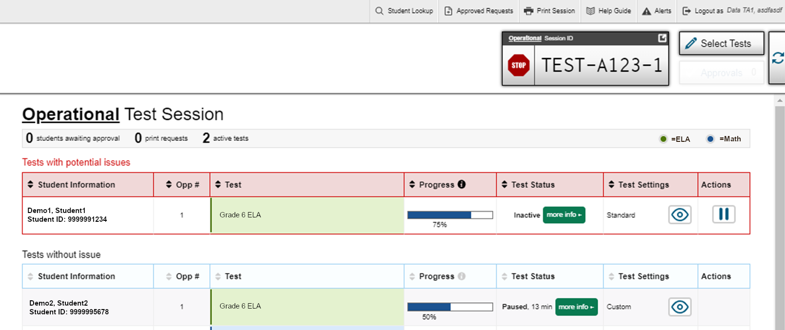
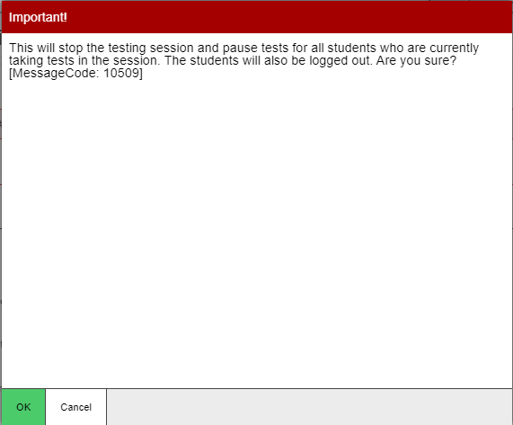
Pausing and Stopping Sessions
When the session has ended, click the STOP icon to automatically pause any tests in your session that are still in progress.
Click Logout to exit the TA interface
Stop

Slide 19
Student Interface

Slide 20
What Is the Secure Browser?
The Secure Browser is designed to ensure test security by prohibiting students from accessing any other programs or websites during testing.
Secure Browser

Slide 21
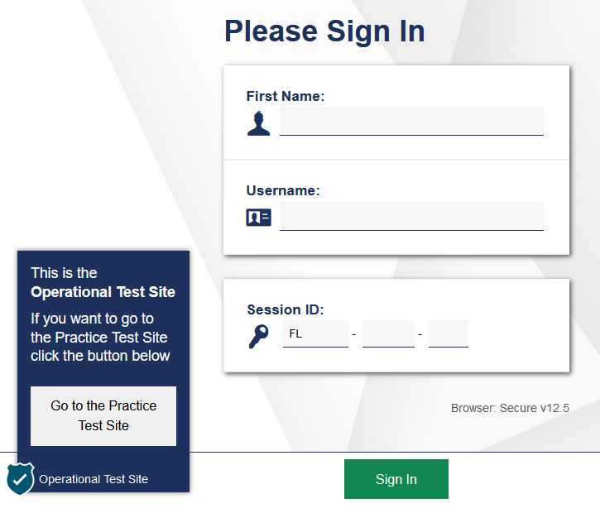
Secure Browser Login
Open the secure browser on each student computer or device to the Sign In screen.
Instruct students to enter their first names and usernames, which are found on their test tickets, and the Session ID, which you have displayed where all students can see it.

Slide 22
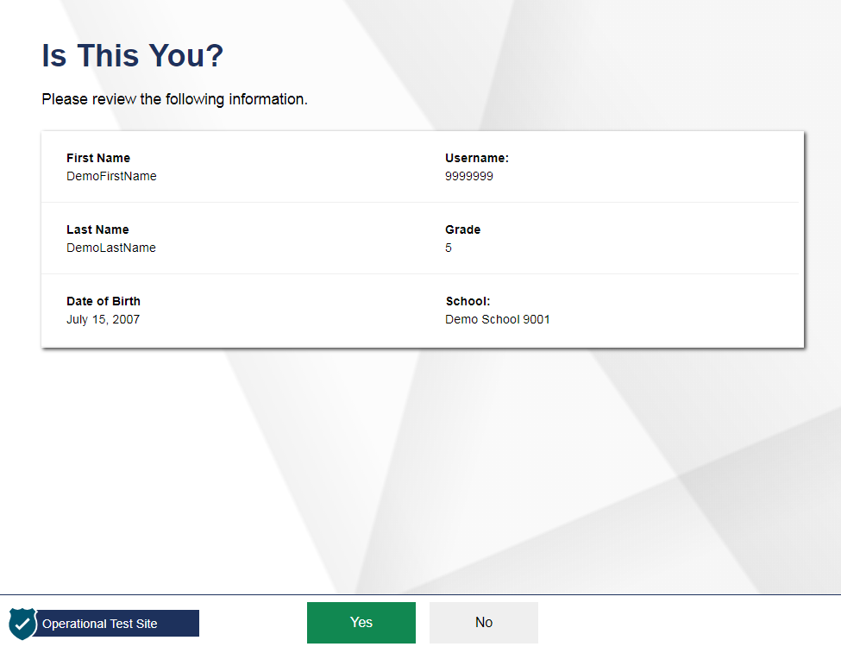
Student Verification

Slide 23
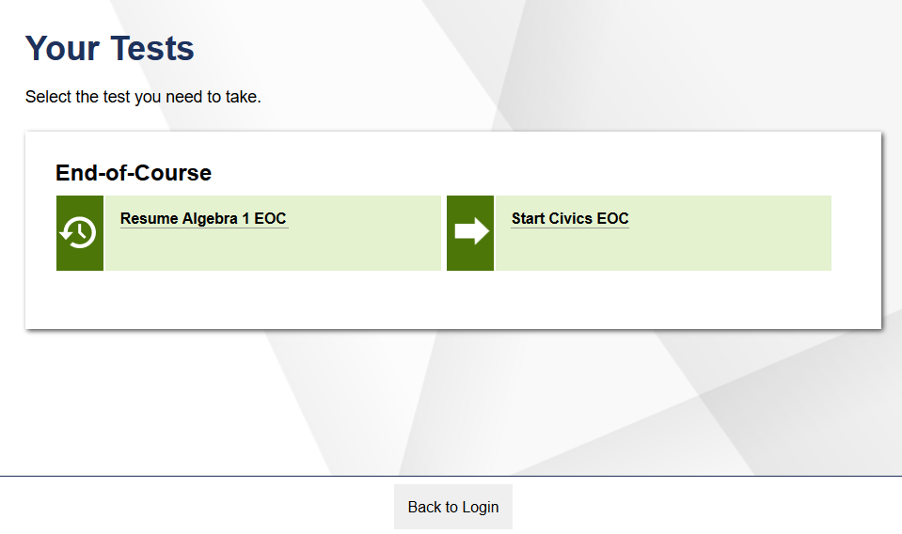
Student Test Selection

Slide 24
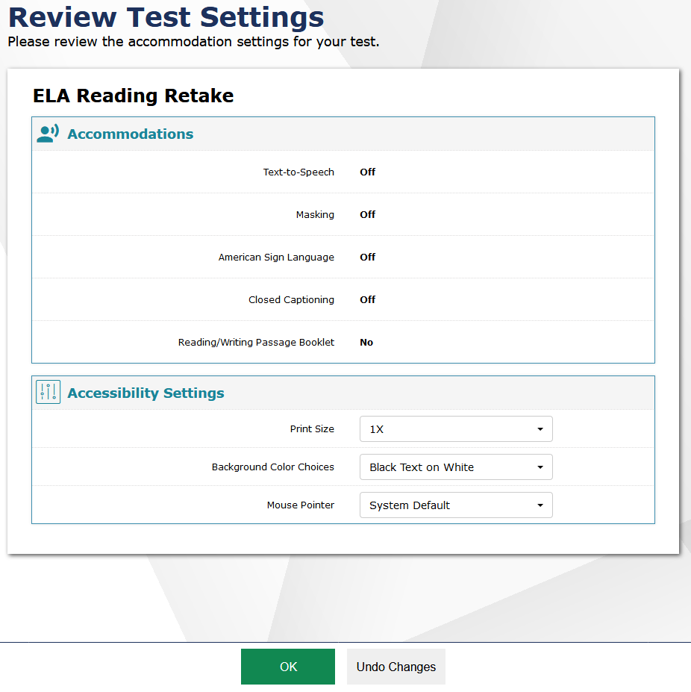
Verifying Test Information

Slide 25
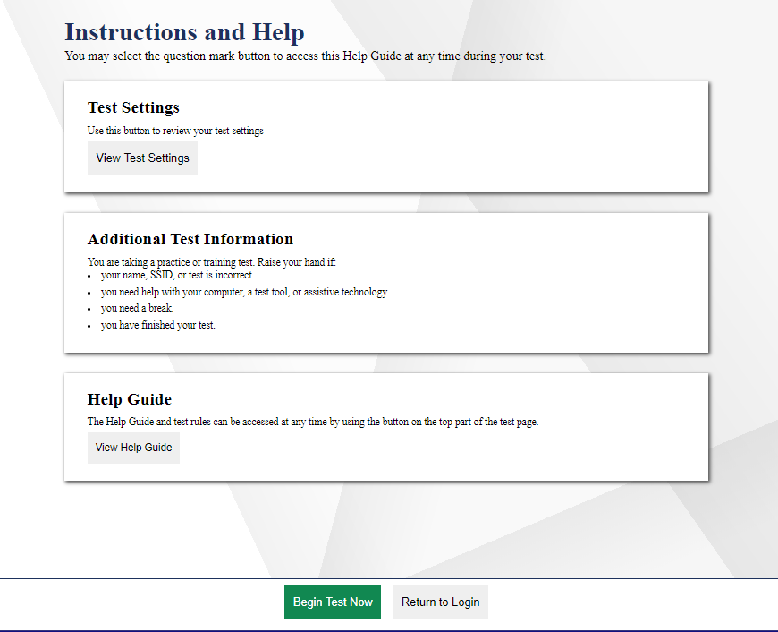
Instructions and Help

Slide 26
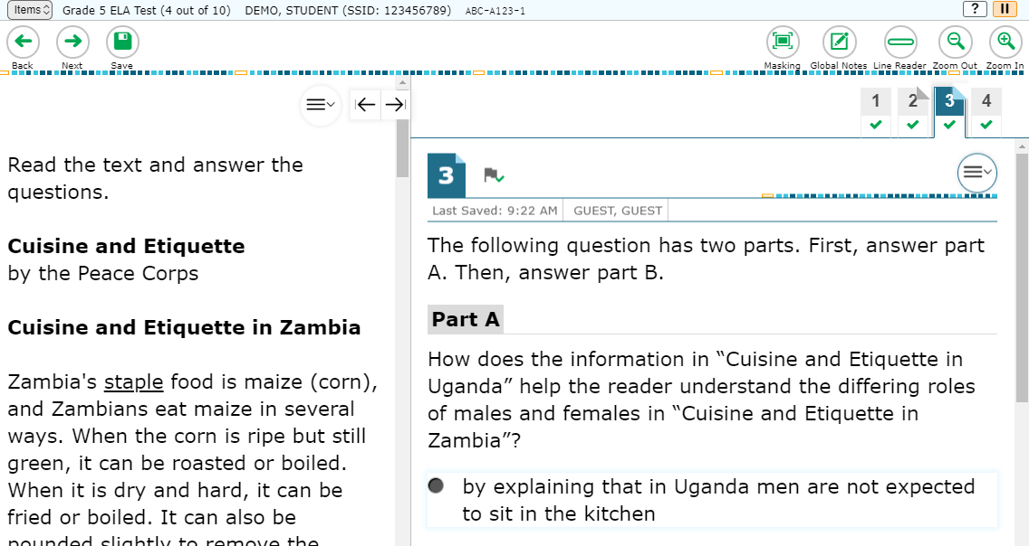
Test Interface

Slide 27
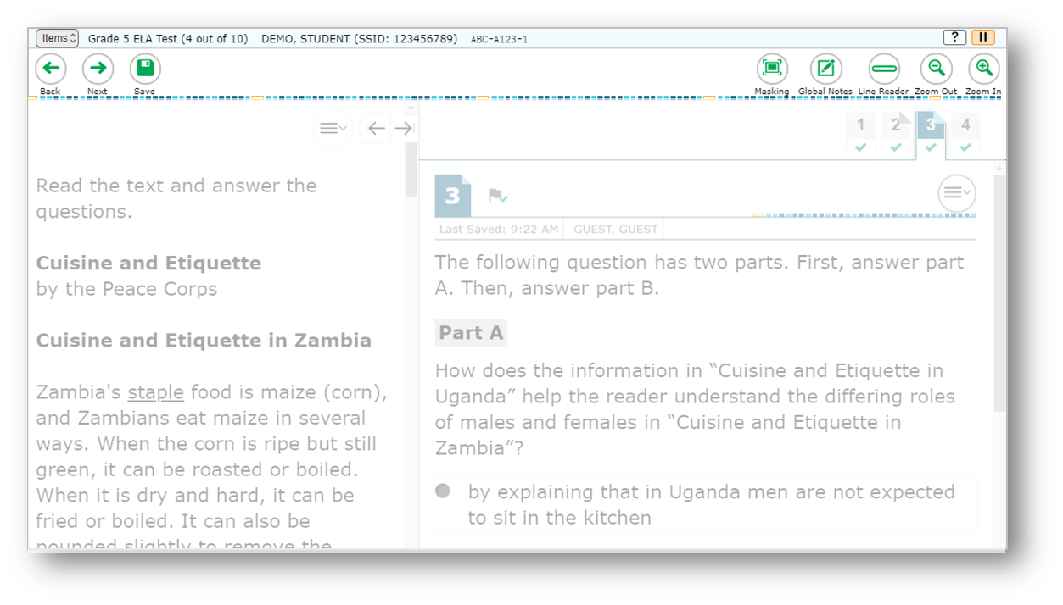
Global Menu
Navigation Buttons
Test Tools

Slide 28
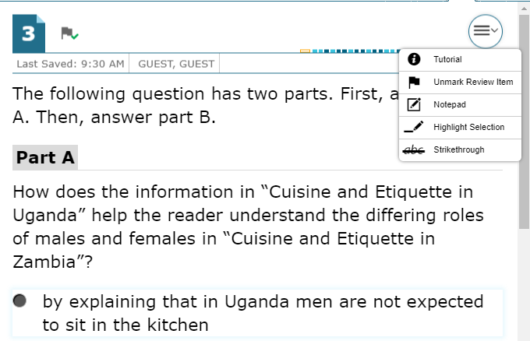
Context Menus
Context menus allow students to:
Mark items for review
View item tutorials
Use a Notepad
Highlight text

Slide 29
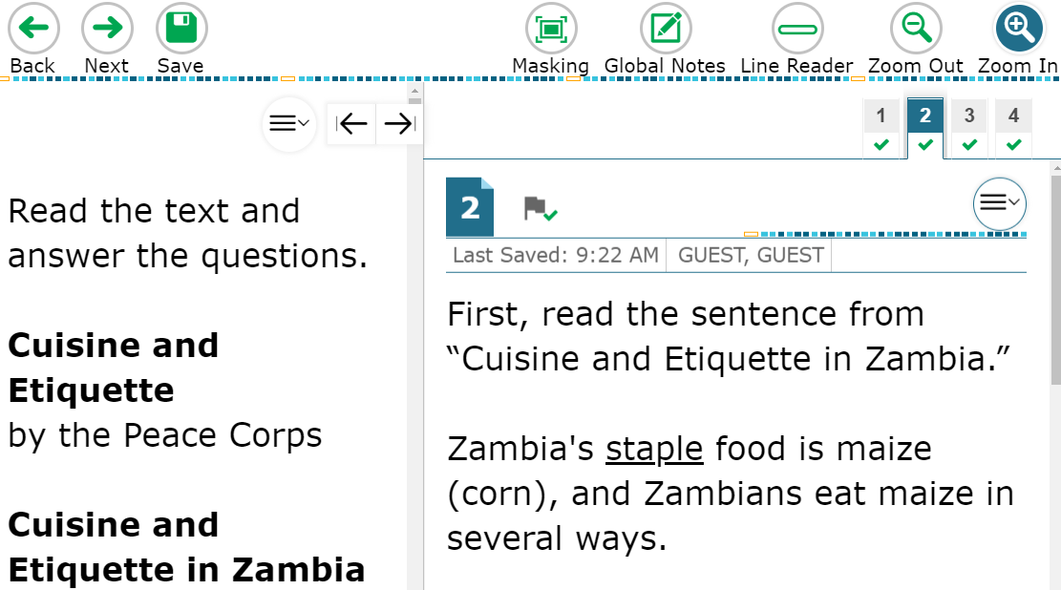
Universal Tools: Zoom

Slide 30
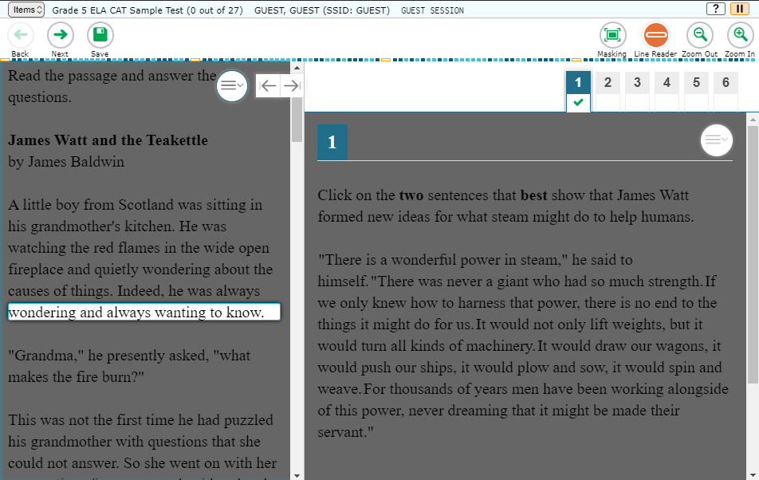
Universal Tools: Line Reader

Slide 31
Accessibility Resources: Color Contrast
Black on White
Black on Rose
Yellow on Blue
Medium Gray on Light Gray
Reverse Contrast (White on Black)

Slide 32
TA Selectable Accommodations
Accommodations, such as Text-to-Speech, and Masking, can be set by Test Administrator on behalf of the student during the login process and before the student begins the test.
Other accommodations like extended time are administered outside of the online platform. The Test Delivery System does not keep time during the test.

Slide 33
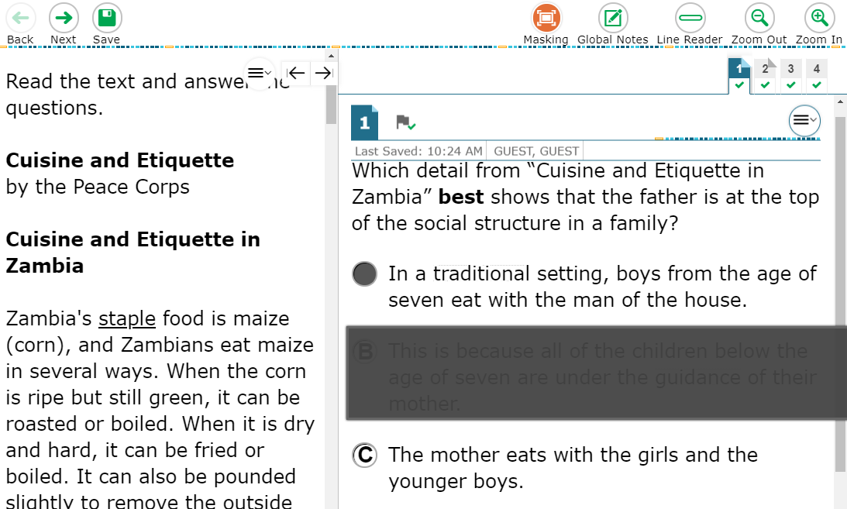
Accommodations: Masking

Slide 34
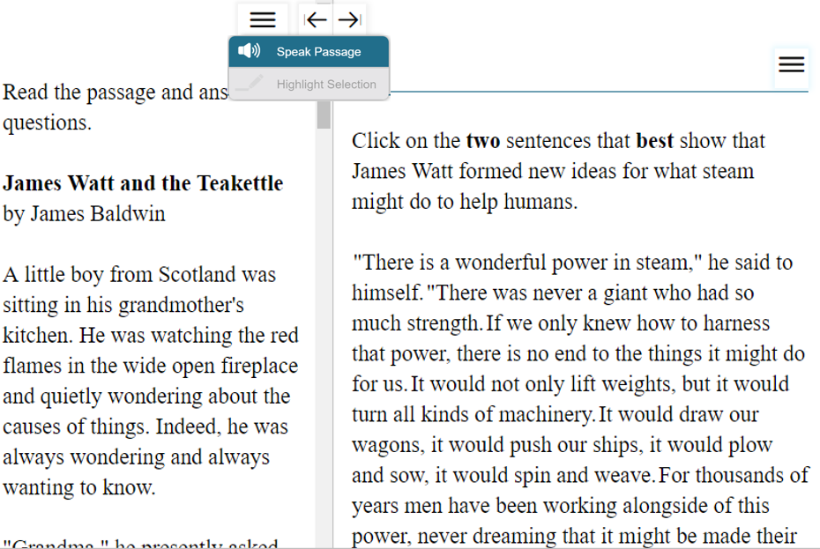
Accommodations: Text-to-Speech

Slide 35
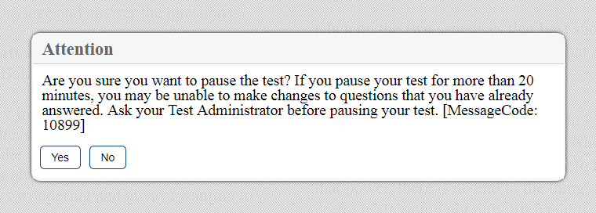
Test Pause

Slide 36
End Test

Slide 37
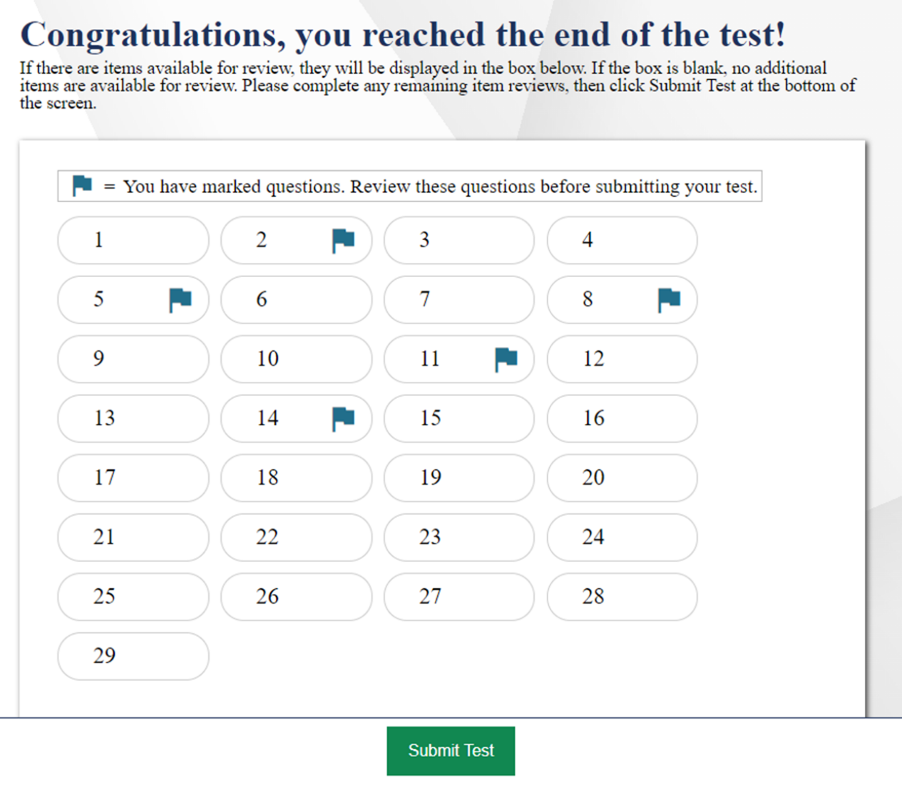
Test Submission

Slide 38
Remote Proctoring

Slide 39
Introduction
The Test Administrator Interface and user experience resemble in-person administrations
The Student Interface and user experience resemble in-person administrations
Remote students use the same Secure Browser to access the same testing website they would access when taking a test at a testing center.
Differences:
Test Proctors are required to take the remote proctoring training course (~30 minutes)
Institutions must obtain permission to have the student appear via webcam (if webcam will be used). This information can be manually added or uploaded in TIDE.
A TP can chat with a student or broadcast a text announcement to an entire class.

Slide 40
Advantages of CAI’s Implementation
Remote test administration and observation
TPs will be able to see and talk to all their students via broadcast or one-on-one. Students cannot see or talk to one another. In fact, students will not know how many other students, if any, are in that test session.
Everything will be on the screen, and student test content will not be obscured by the new functionality.
No intermediary. Security, privacy, and performance are a priority.
All video conferencing capabilities happen over a peer-to-peer connection between the TP and students’ machines. After a connection is made between the two parties, CAI will not have the ability to view ongoing conversations.
Nothing will be recorded, saved or routed through CAI’s servers, so the introduction of this feature will have no performance impact on the existing system capacity.

Slide 41
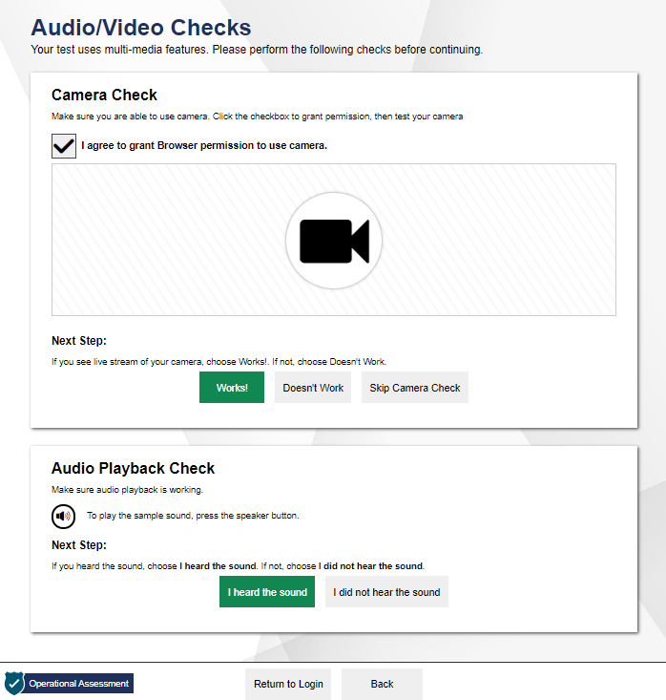
Ensuring that Teacher and Remote Student Hardware is Functioning
https://check_my_speed

Slide 42
Viewing Students in Your Remote Test Session: Table View

Slide 43
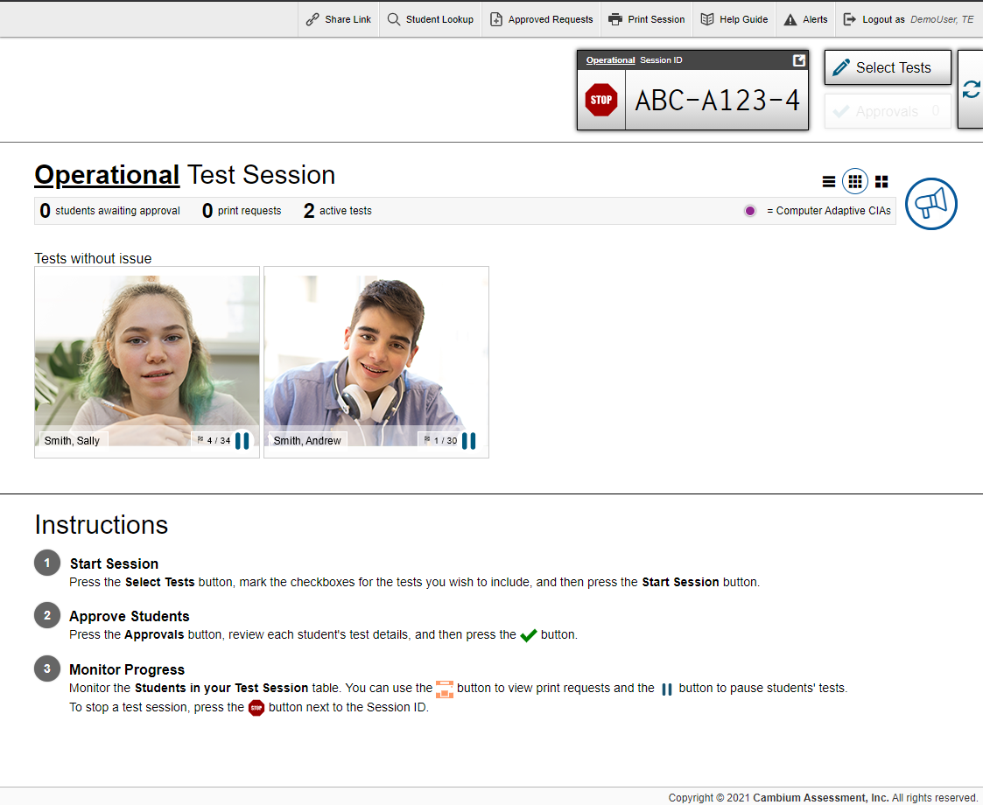
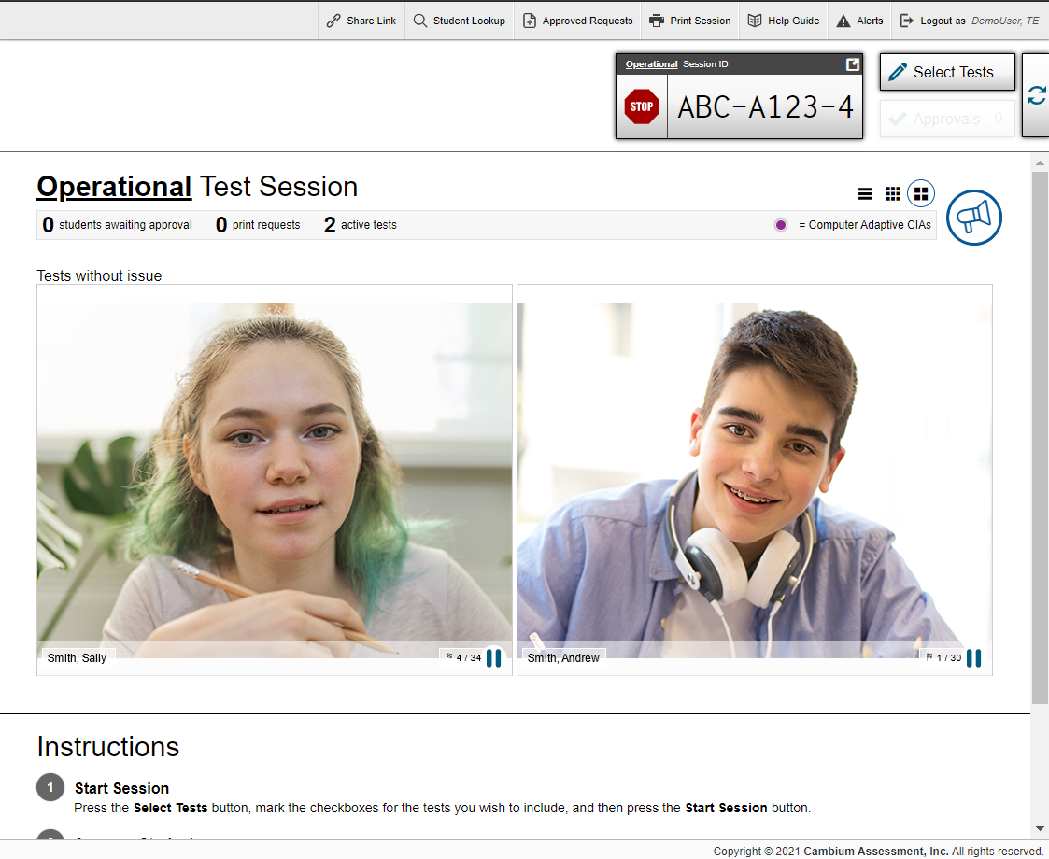
Viewing Students in Your Remote Test Session: Tile Views
3x3 Tile View
2x2 Tile View

Slide 44
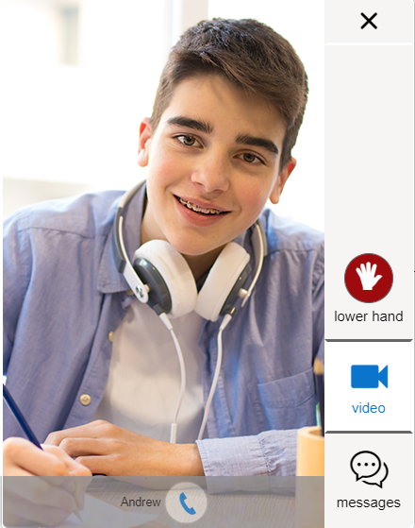
Observing Individual Students
Low-resolution of all students
High-resolution of one student

Slide 45
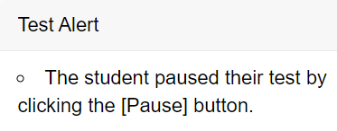
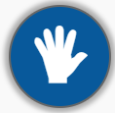
Communicating with Students
Communication/ Monitoring Feature | Who initiates the communication | How to use the feature
Broadcast Message | Teacher initiated | The teacher uses this feature to send a chat message to all students at one time. Students can respond by sending a chat message to the teacher.
Test Alert | Student initiated | Teachers will receive an alert if the testing system detects a problem with the student’s test.
Screenshare Feature | Teacher initiated Student must grant permission | Teachers can view a student’s screen after student grants permission.
Chat Message | Teacher or student initiated | Both the teacher and student can communicate at any time beginning when the student is waiting for the teacher to approve students
Video Conference* | Teacher initiated | Teachers and students can have a one-to-one video conference
Raise Hand Feature | Student initiated | Students can request help by virtually raising their hand. Teachers can respond via chat message or video conference.

Slide 46
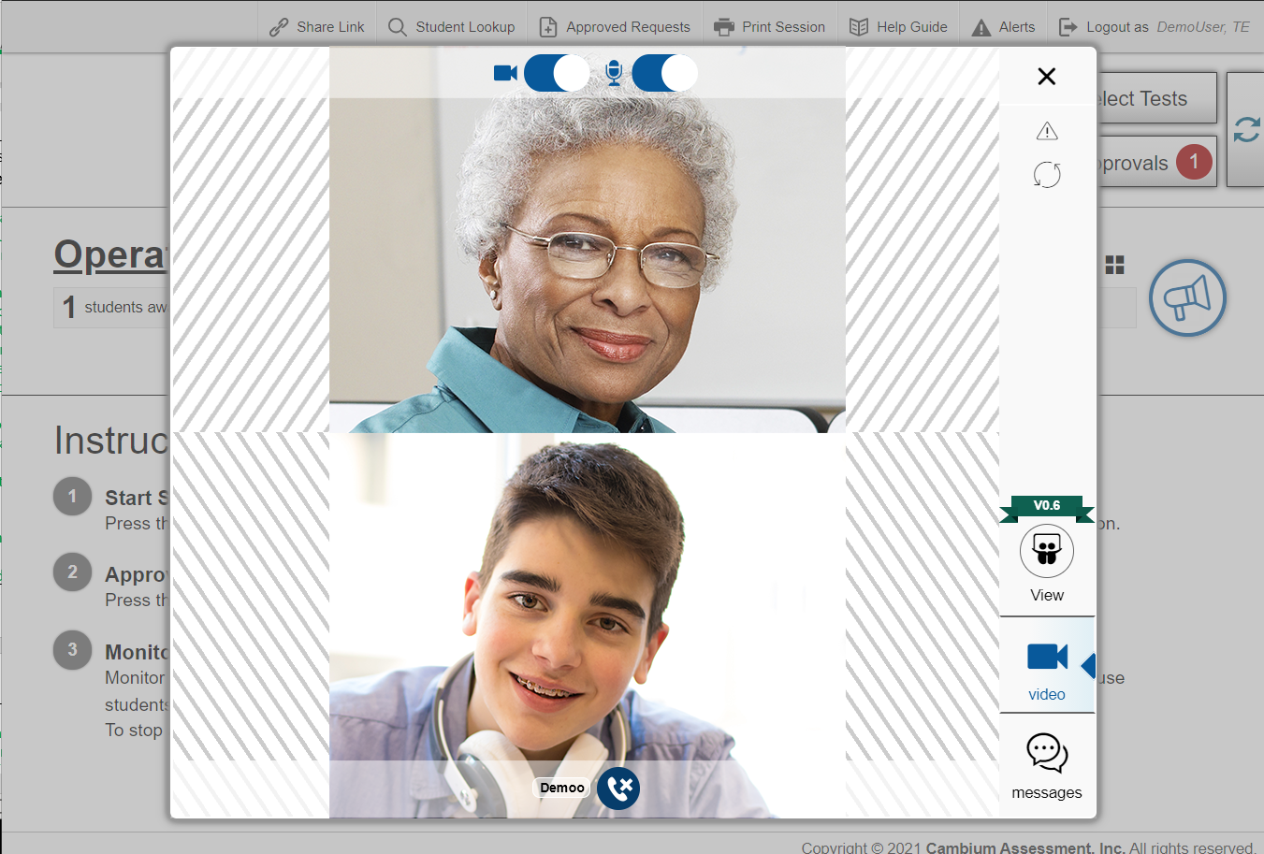
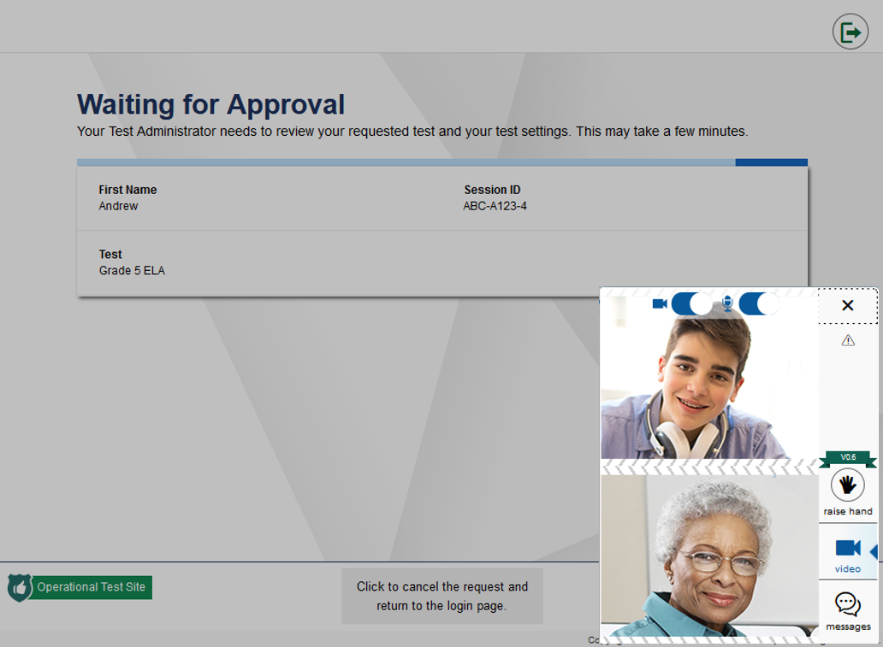
How to Proctors and Students can Communicate via Video Conference
Teacher Screen
Student Screen
Turn off webcam and mic
Turn off webcam and mic

Slide 47
Troubleshooting
Description | What to Do
What should I do if a test session ends? | Log in and start a new session. Provide the students with a new session ID.
What should I do if a student gets logged out of a test while a session is still active? | If a student’s test session is interrupted, the student should log back in and rejoin the session.
What should I do if forbidden applications are running? | The Secure Browser will not allow the student to begin testing if forbidden applications are running. You will see messages advising you which applications must be closed before testing can begin.
What should I do if a student’s test freezes? | Force-quit the Secure Browser and log back in. For instructions, refer to the Test Administration Manual.
Notes:
This table presents some of the common issues that you or your students may encounter during a test session. Please take a moment to review this information. For more detailed information please refer to your Test Administration Manual.

Slide 48
APM-Reporting site
2021-2022
Copyright © 2021 Cambium Assessment, Inc. All rights reserved.

Slide 49
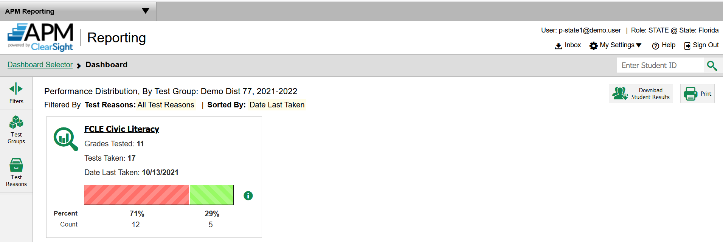
APM-Reporting Dashboard
Test Results are reported immediately to authorized users in the
APM-Reporting Site.

Slide 51
District, School Summary
Notes:
District = State Colleges or State Universities

Slide 52
Performance Summary by School, Domain

Slide 53
Performance by Roster

Slide 54
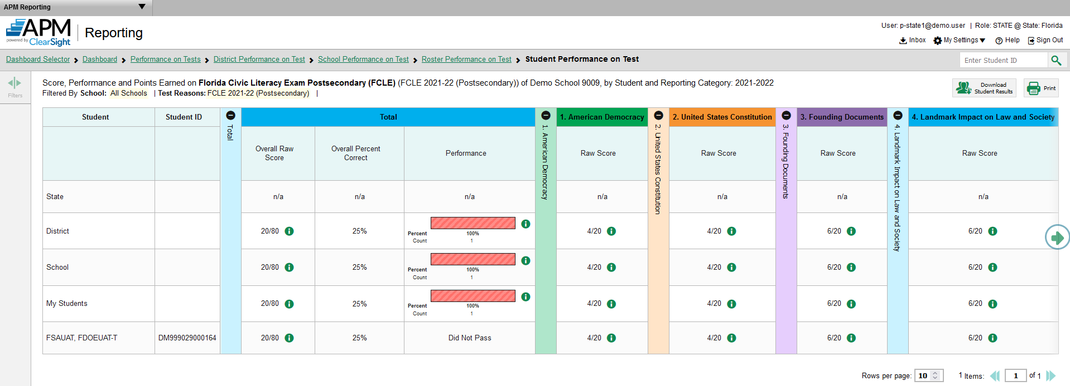
Performance by Student

Slide 55
User Support
The Florida Help Desk is open Monday–Friday from 7:00 a.m. to 8:30 p.m. Eastern Time (except holidays).
Florida Help Desk
Toll-Free Phone Support: 1-866-815-7246
Email Support: FloridaHelpDesk@CambiumAssessment.com
Please provide detailed information that may include the following:
FLEID, associated district (79 = State Universities; 80 = State Colleges), and associated school for a student.
For a TIDE user, provide the user's full name and email address.
Any error messages that appeared.
Device, operating system, and browser information, including version numbers.
Press “3” for FCLE questions!

